Slide 1

Racial Equity in
Arts Funding Workshop
Online|May 8, 2024
Notes:
Assignments in advance of participation:
Watch the August 2018 Race Forward webinar on race on GIA’s website
Consider a possible vision of racial equity that could be manifest in your organization or entity in 25 years and bring to the workshop
Consider the challenges you’ve experienced related to racial equity in your organization or agency
Consider efforts or interventions solutions to these kinds of challenges you have executed, experienced, observed or heard of
Questions to share while they watch the webinar:
How does your organization or agency contribute to a culture of silence?
Interrupt a culture of silence?
What are some examples of organizational strategies (communications, external engagement etc) you’re currently using to interrupt a culture a of silence ?
Day 1:
Welcome
Intro Activity
Overview + Goals
Group Agreements
Overview of the Day
Welcomes from: Eddie from GIA, local funders and RF
Understand key concepts related to structural racism.
Explore the expression of structural racism in the arts sector.
Identify opportunities for further learning and action to address structural and institutional racism in your organization or agency.
Explore how arts funders can shift resources or find new resources to support artists of color/African, Latinx, Asian, Arab and Native American (ALAANA) artists and arts organizations of people and communities of color.
Interventions or strategies, rather than solutions?
Option to have informal drinks and mingling instead

Slide 2
Welcome!
‹#›

Slide 3
Land Acknowledgements
GIA is headquartered on the unceded land of the Lenape and Wappinger peoples.
We ask you to join in acknowledging the Lenape and Wappinger communities, their elders both past and present, as well as future generations.
This acknowledgement demonstrates a commitment to beginning the process of working to dismantle the ongoing legacies of settler colonialism.
Notes:
GIA is headquartered on the unceded land of the Lenape and Wappinger peoples.
We ask you to join in acknowledging the Lenape and Wappinger communities, their elders both past and present, as well as future generations.
This acknowledgement demonstrates a commitment to beginning the process of working to dismantle the ongoing legacies of settler colonialism.

Slide 4
Story Huddle
‹#›
Notes:
Give instructions for how to engage in activity:
Find a partner, in 2 or 3 minutes exchange answers to the following questions.
With each new question, find a different partner to share with, someone you haven’t shared with before.

Slide 5
Story Huddle: Getting to know the room
What is a value you inherited from
someone in your life?
‹#›

Slide 6
Story Huddle: Getting to know the room
What is a value that you had to unlearn as it no longer served you?
‹#›
Notes:
2 minutes each
Throughout this series, really the foundation of what we’ll be doing together is investigating our values, both learned and inherited, and determining which need to be unlearned or reimagined. There may be multiple times where our natural dialogue brings us back to this idea of our root values.

Slide 7
Presenters
Jonny Soto-Altrogge, Facilitator, True North EDI
Nadia Elokdah, VP & Director of Programs, Grantmakers in the Arts
Jaime Sharp, Program Manager, Grantmakers in the Arts
Eddie Torres, President & CEO, Grantmakers in the Arts
Notes:
NADIA
Initial introductions for the room go-around: name, organization, gender pronouns

Slide 8
Overview of the Day
‹#›
Notes:
NADIA

Slide 9
Workshop Goals
‹#›

Slide 10
Workshop Goals:
Explore key concepts relative to structural racism.
Consider how racism manifests in our sector.
Identify institutional barriers to racial equity.
Strategize how our sector might shift power to artists and organizations led by/serving people of color, working for racial justice.
Making the work of realizing racial equity in arts funding tangible.
‹#›

Slide 11
Engagement Norms
Chat Norms
Please feel free to eat, stretch, and move.
Your kids, creatures, and podmates
are welcome!
We’d love to see you, but welcome you to turn off your camera if it is supportive for you.
Turn off your mic in the large group.
Please share your name when starting to speak so that everyone knows who is talking.
Here’s how we encourage you to use the chat:
  Respond to a prompt
  Type “stack” if you’d like to share something aloud or volunteer
  Share resources and tools
  Give each other affirmations ++
  Private chat Nadia if you need tech support
We may summarize ideas we see in the group chat aloud.
‹#›

Slide 12

Group Agreements:
Occupy Brave Space
Commit to staying in your “Stretch Zone”
Honor selective vulnerability
Acknowledge that everyone brings cultural knowledge to the discussion
Hold space for:
  a spectrum of experience in navigating these circumstances
  a spectrum of experience in relationship to the content
Share the air / One mic
What is said stays, what is learned is leaves
Accept and expect a lack of closure
Source: YES! Jam Facilitator
‹#›

Slide 13
Overview of the Day
Will Do
Introduce why we lead with race, and do so intersectionally
Dig into the barriers of discussing race
Understand how race is constructed and operates
Distill what was shared in this session and prep for next week
Might Do
Unpack how structural racism operates in your life and work
Won’t Do
Leave today with complete resolution
‹#›

Slide 14
Leading with Race
‹#›
Notes:
Jaime and Eddie

Slide 15
Four Key Facts
1) Race is a construct and is not biologically determined. Race is a modern idea.
2) Policy drives the social construction of race and has contributed to changing ideas and definitions of race over time.
3) We did not choose this system, but we have a responsibility to address it.
4) Our goal is racial equity as a means toward racial justice and liberation
‹#›
Notes:
Jaime

Slide 16
Equity
Resources and power for communities
Points of intervention: policies, systems, structures
Increasing justice and fairness within the procedures and processes of institutions/systems, as well as in their distribution of resources
Equity is a unique opportunity for funders because of their unique power:
  Resources
  Intervention at a broader scale than just one institution/agency but instead at the scale of a funding portfolio
‹#›
Notes:
Eddie
Equity
The focus is on resources and power for communities (as defined by geography or identity or both)
Requires systemic changes that redress historic subjugation to create and increase self-determination by those affected
Equity is a unique opportunity for funders for two reasons:
Funders have resources at their disposal.
Diversity and Inclusion are interventions at the level of a solitary institution. Equity can be an intervention at a broader scale – at the scale of a philanthropic portfolio.

Slide 17
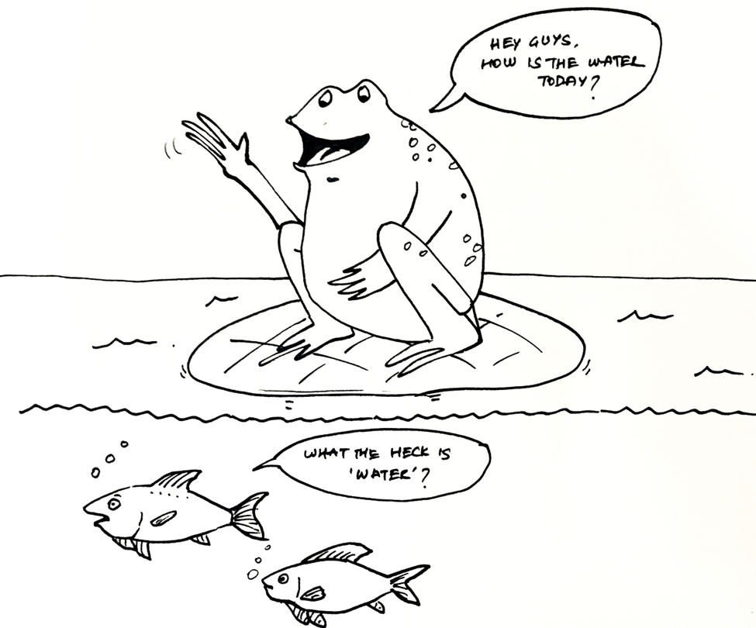
From Sarwesh Shah
‹#›
Notes:
Leading with Race – popcorn with group - Jaime
What do you notice in this cartoon?
What is it important to note and how does it translate into our own lives?
I wonder about having a specific take away message we want to deliver with this image. Some folks are “defending” the frog which isn’t necessarily wrong, and what do we want folks to take away?

Slide 18
Why Lead with Race?
Within oppressed peoples’ communities, people of color still face the worst social outcomes
Strategies of combining considerations of race with other considerations too often result in racialized people being pushed into the background or ignored
The U.S.’ creation of race was established to keep oppressed peoples separate.
‹#›
Notes:
Eddie - popcorn w/ group
GIA has made a strategic decision to foreground racial equity in our work for several reasons:
Within other oppressed peoples’ communities (including women, members of the lgbtqi community, people with disabilities, and others), people of color still face the worst social outcomes.
For instance, according to the Institute for Women’s Policy Research:
Median weekly earnings of white women are 81.5% of the median weekly earnings of white men
Median weekly earnings of Black women are 65.3% of the median weekly earnings of white men
Median weekly earnings of Latinx women are 61.6% of the median weekly earnings of white men
According to the National Coalition Against Domestic Violence:
American Indian and Alaska Native women experience assault and domestic violence at much higher rates than women of any other ethnicity.
Over 84% of Native women experience violence during their lifetimes.
On some reservations in the United States, the murder rate of Native women is 10 times higher than in the rest of the nation.
According to LGBT Funders and National Center for Transgender Equality and National Gay and Lesbian Task Force:
Trans people, in the aggregate, are twice as likely to live in extreme poverty (earning under $10,000 a year) as the general U.S. population
Latinx transgender people face seven times the poverty rate of the general population
Black transgender people face eight times the poverty rate of the general population
According to the Human Rights Campaign
While 72% of Americans are white, since 2013 only 20% of the trans people that have been victims of fatal violence in the U.S. have been white
80% of the trans people that have been victims of fatal violence in the U.S. have been people of color
According to National Disability Institute
24% of non-Hispanic white people with a disability live in poverty
40% of African American people with a disability live in poverty
GIA feels that others’ strategies of combining considerations of race with other considerations (gender, disability, etc.) too often result in considerations of race being pushed into the background or ignored.
For instance, studies by the U.S. Department of Labor and the American Association of University Women found that in the first two decades of affirmative action, the greatest growth in career and education has been experienced by white women, rather than by any racialized group.
The U.S.’ creation of race was established to keep oppressed peoples separate.
Unless we articulate our support for racialized peoples, while calling out this separation strategy, we inadvertently reinforce this separation strategy.
For instance, according to the 2014 Cooperative Congressional Election Study, nearly 70% of the self-identified non-Hispanic white women – those most helped by affirmative action - surveyed either somewhat or strongly opposed affirmative action for people of color.
This is an example of an all too frequent phenomenon – the use of race as the means to convince people who are being helped by a policy or practice to disavow that policy or practice as a give-away for people of color.
Another example: According to the Center on Budget and Policy Priorities, white people made up the largest share - 52% - of people lifted from poverty by safety-net programs, while black people made up less than a quarter of that share.
When it comes to receiving Medicaid, white people make up about 43% of recipients.
According to the U.S. Department of Agriculture, white people made up the largest share (36.2%) of any ethnic group receiving benefits from the Supplemental Nutrition Assistance Program – commonly called food stamps.
A 2018 study conducted by researchers at Stanford University and University of California, Berkeley, found that whites’ decreasing support for social safety net programs correlated with increasing racial resentment.
The study found that when white participants were told that whites continue to be the “largest single ethnic group in the United States,” they proposed cutting $28 million from federal welfare spending.
Those told that whites’ population share is “substantially declining” proposed cutting $51 million.
The study also found whites were less likely to support programs that benefited minorities if they had been told that the achievement gap between white and minority incomes is closing.
White participants who opposed a welfare program benefiting minorities went on to support a program benefiting whites.
GIA believes that all oppressed groups should benefit from assistance efforts. We give primacy to race because racism is the means by which oppressed groups are manipulated into opposing programs that assist them. Therefore, Grantmakers in the Arts’ equity work – including our discussions of support for trans artists, artists with disabilities and for disability arts – is NOT race-exclusive but IS race-explicit. GIA’s vision for the future of our work in support of racial equity in arts funding is to increasingly reveal how that the liberation of all oppressed people is interdependent.

Slide 19
Why Lead with Race? Within oppressed peoples’ communities, people of color still face the worst social outcomes
Women’s earnings: White women $0.81 on the dollar; Black women $0.65; Latinx women $0.62
Trans people & violence: 72% of Americans are White; 80% of the trans people that have been victims of fatal violence have been BIPOC
Trans people & poverty: White 2x as likely as the general population to live in extreme poverty: Latinx transgender 7x; Black transgender 8x
Disability & poverty: 24% of White people with a disability live in poverty; 40% of Black people with a disability live in poverty
‹#›
Notes:
5 minutes: EDDIE
Within other oppressed peoples’ communities (including women, members of the lgbtqi community, people with disabilities, and others), people of color still face the worst social outcomes.
For instance, according to the Institute for Women’s Policy Research:
Median weekly earnings of white women are 81.5% of the median weekly earnings of white men
Median weekly earnings of Black women are 65.3% of the median weekly earnings of white men
Median weekly earnings of Latinx women are 61.6% of the median weekly earnings of white men
According to the National Coalition Against Domestic Violence:
American Indian and Alaska Native women experience assault and domestic violence at much higher rates than women of any other ethnicity.
Over 84% of Native women experience violence during their lifetimes.
On some reservations in the United States, the murder rate of Native women is 10 times higher than in the rest of the nation.
According to LGBT Funders and National Center for Transgender Equality and National Gay and Lesbian Task Force:
Trans people, in the aggregate, are twice as likely to live in extreme poverty (earning under $10,000 a year) as the general U.S. population
Latinx transgender people face seven times the poverty rate of the general population
Black transgender people face eight times the poverty rate of the general population
According to the Human Rights Campaign
While 72% of Americans are white, since 2013 only 20% of the trans people that have been victims of fatal violence in the U.S. have been white
80% of the trans people that have been victims of fatal violence in the U.S. have been people of color
According to National Disability Institute
24% of non-Hispanic white people with a disability live in poverty
40% of African American people with a disability live in poverty

Slide 20
Why Lead with Race? Combining race with other considerations: racialized people being pushed into the background
Affirmative action
‹#›
Notes:
5 minutes: EDDIE
GIA feels that others’ strategies of combining considerations of race with other considerations (gender, disability, etc.) too often result in considerations of race being pushed into the background or ignored.
For instance, studies by the U.S. Department of Labor and the American Association of University Women found that in the first two decades of affirmative action, the greatest growth in career and education has been experienced by white women, rather than by any racialized group.

Slide 21
Why Lead with Race? The U.S.’ creation of race was established to keep oppressed peoples separate.
Race is a means to convince people who are being helped by a policy or practice to disavow it
White women who oppose affirmative action
Whites who oppose safety-net programs
‹#›
Notes:
5 minutes: EDDIE
The U.S.’ creation of race was established to keep oppressed peoples separate.
Unless we articulate our support for racialized peoples, while calling out this separation strategy, we inadvertently reinforce this separation strategy.
For instance, according to the 2014 Cooperative Congressional Election Study, nearly 70% of the self-identified non-Hispanic white women – those most helped by affirmative action - surveyed either somewhat or strongly opposed affirmative action for people of color.
This is an example of an all too frequent phenomenon – the use of race as the means to convince people who are being helped by a policy or practice to disavow that policy or practice as a give-away for people of color.
Another example: According to the Center on Budget and Policy Priorities, white people made up the largest share - 52% - of people lifted from poverty by safety-net programs, while black people made up less than a quarter of that share.
When it comes to receiving Medicaid, white people make up about 43% of recipients.
According to the U.S. Department of Agriculture, white people made up the largest share (36.2%) of any ethnic group receiving benefits from the Supplemental Nutrition Assistance Program – commonly called food stamps.
A 2018 study conducted by researchers at Stanford University and University of California, Berkeley, found that whites’ decreasing support for social safety net programs correlated with increasing racial resentment.
The study found that when white participants were told that whites continue to be the “largest single ethnic group in the United States,” they proposed cutting $28 million from federal welfare spending.
Those told that whites’ population share is “substantially declining” proposed cutting $51 million.
The study also found whites were less likely to support programs that benefited minorities if they had been told that the achievement gap between white and minority incomes is closing.
White participants who opposed a welfare program benefiting minorities went on to support a program benefiting whites.

Slide 22
Barriers to Authentic Dialogue
‹#›

Slide 23
Share in the chat..
What gets in the way of meaningful and authentic conversations about race, power, and/or privilege?
‹#›

Slide 24
Having the Conversation
Watch the following conversation. Stay present to what you observe, hear, and feel. Be prepared to share.
‹#›

Slide 25

James Baldwin on The Dick Cavett Show [1968]
‹#›
Notes:
(23) Baldwin on Dick Cavett - YouTube
Early Experiences with Race - Jonny
3 minutes
https://youtu.be/_fZQQ7o16yQ

Slide 26
Having the Conversation
What did you observe or notice about this interaction? What played out?
‹#›

Slide 27

How were you raised to talk/think about race?
Derald Wing Sue is an educational psychologist who identifies three protocols that fundamentally impede our ability to meaningfully participate in dialogue around power and privilege.
‹#›

Slide 28
Race Talk Protocols
SHARE: What is lost and what is gained when these protocols are in place?
‹#›

Slide 29
Race Talk Protocols
POLITENESS PROTOCOL dictates that potentially offensive or uncomfortable topics should be (a) avoided, ignored, and silenced or (b) spoken about in a very light or superficial manner.
‹#›

Slide 30
Race Talk Protocols
ACADEMIC PROTOCOL manifests in both academic and professional environments as the expression of strong and/or intense emotions being discouraged. In these spaces, intellectual inquiry is prioritized and is characterized by objectivity, detachment, and rational discourse.
‹#›

Slide 31
Race Talk Protocols
In ACADEMIC PROTOCOL, elevation of the mind over the body dictates that these environments should
be conducted in a sterile, objective decorum devoid
of feelings.
‹#›

Slide 32
Race Talk Protocols
COLORBLIND PROTOCOL, or colorblindness, is the belief that race (and/or other identity markers) do not matter, that we should be a “colorblind” society, and that people should be judged on the basis of their internal attributes and not their race, gender,
socio-economic status, etc.
‹#›

Slide 33
Systemic Racial Equity
‹#›

Slide 34
“Race is the child of racism,
not the father.”
– Ta-Nehisi Coates
‹#›
Notes:
NADIA
In his book, Between the World and Me, Coates writes about race, but he argues that race itself is a flawed, if not useless, concept—it is, if anything, nothing more than a pretext for racism. Early in the book he writes, “Race, is the child of racism, not the father.” The idea of race has been so important in the history of America and in the self-identification of its people—and racial designations have literally marked the difference between life and death in some instances.

Slide 35
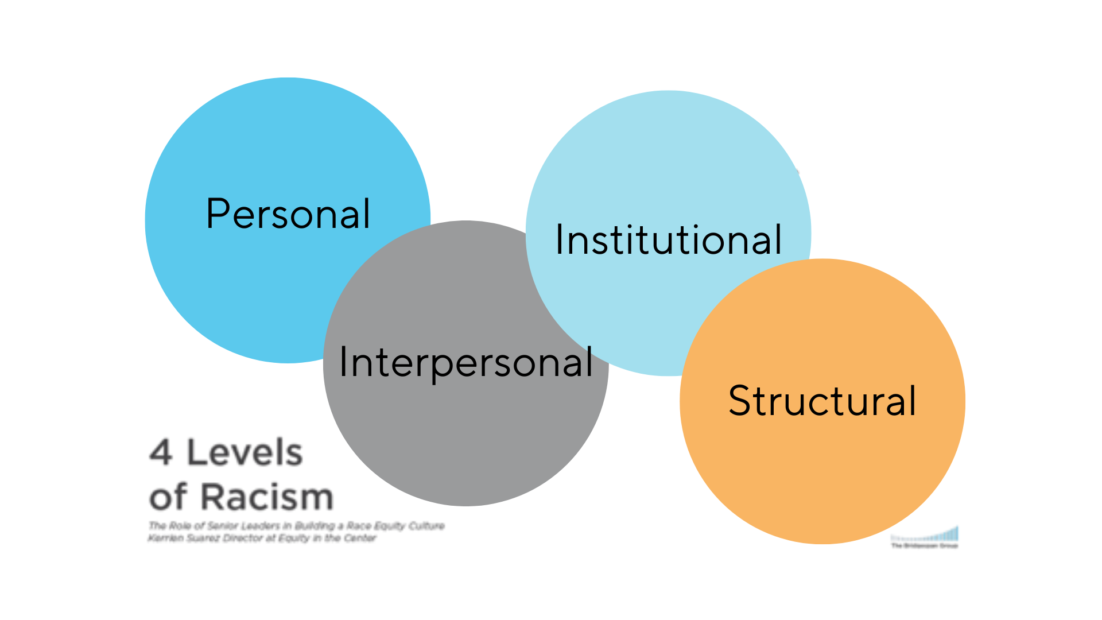
Four Levels of Racism
  “SYMPTOMS” [MICRO]
  “SYSTEMS” [MACRO]
‹#›
Notes:
Nadia
Maybe this one instead? https://docs.google.com/presentation/d/1MPG9MlfOAetbdA3R95VINmF3UNHP76ZyduVUuluUjDo/edit?usp=sharing
Key Concepts Related to Race – Nadia + Jonny
Key Concepts Related to Race: 30 minutes (1:30 – 2:00)
Hook: “Racism is the father of race, not the child” Coates
Screen share: Types of Racism: / 4 layers (lens of analysis)
Four Levels of Racism: Interpersonal, Institutional, Systemic, Structural
Dimensions of structural racism without an active actor, becomes colorblind racism
King Johnson Letter: Breakouts (return to 4 breakout rooms previously assigned): developing the skills needed later to unpack case studies in culture module
Screen share: Strategies to address different levels of racism: Nadia
The concept of categorizing folks by difference of perception led to the creation of that categorization system, and initially (and still is) used to

Slide 36
Four Levels of Racism
go to Menti.com
enter code: 7278 5859
‹#›
Notes:
Nadia
Maybe this one instead? https://docs.google.com/presentation/d/1MPG9MlfOAetbdA3R95VINmF3UNHP76ZyduVUuluUjDo/edit?usp=sharing
Key Concepts Related to Race – Nadia + Jonny
Key Concepts Related to Race: 30 minutes (1:30 – 2:00)
Hook: “Racism is the father of race, not the child” Coates
Screen share: Types of Racism: / 4 layers (lens of analysis)
Four Levels of Racism: Interpersonal, Institutional, Systemic, Structural
Dimensions of structural racism without an active actor, becomes colorblind racism
King Johnson Letter: Breakouts (return to 4 breakout rooms previously assigned): developing the skills needed later to unpack case studies in culture module
Screen share: Strategies to address different levels of racism: Nadia
The concept of categorizing folks by difference of perception led to the creation of that categorization system, and initially (and still is) used to

Slide 37
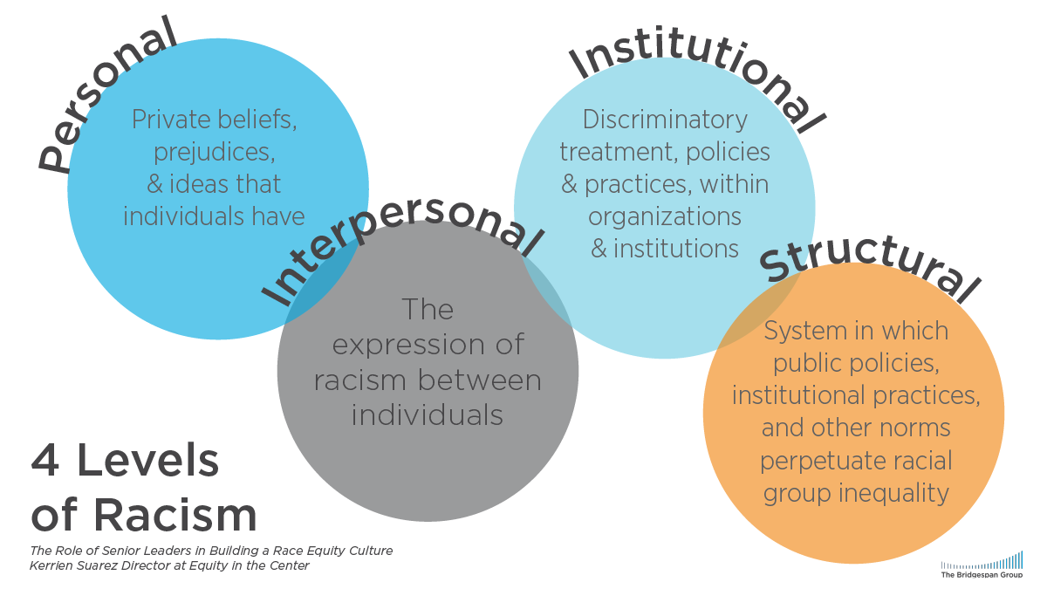
Four Levels of Racism
  “SYMPTOMS” [MICRO]
  “SYSTEMS” [MACRO]
‹#›
Notes:
Nadia
Maybe this one instead? https://docs.google.com/presentation/d/1MPG9MlfOAetbdA3R95VINmF3UNHP76ZyduVUuluUjDo/edit?usp=sharing
Key Concepts Related to Race – Nadia + Jonny
Key Concepts Related to Race: 30 minutes (1:30 – 2:00)
Hook: “Racism is the father of race, not the child” Coates
Screen share: Types of Racism: / 4 layers (lens of analysis)
Four Levels of Racism: Interpersonal, Institutional, Systemic, Structural
Dimensions of structural racism without an active actor, becomes colorblind racism
King Johnson Letter: Breakouts (return to 4 breakout rooms previously assigned): developing the skills needed later to unpack case studies in culture module
Screen share: Strategies to address different levels of racism: Nadia
The concept of categorizing folks by difference of perception led to the creation of that categorization system, and initially (and still is) used to

Slide 38
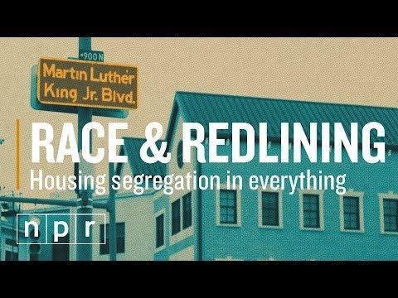

Slide 39
Equity: Policies, Systems, Structures
Housing
Property taxes & schools
From historic policy to present practice
Access & outcomes
Education
Arts access
Cops in schools
Courts
Framing & investment
‹#›
Notes:
Racial Equity and Justice – EDDIE
The arts benefit students academically
Longitudinal studies indicate that arts education increases literacy, advances math achievement, engages students in school, and motivates them to learn.
Low-income communities’ schools have less access to the arts
A 2009 report by the Government Accountability Office found that schools designated under No Child Left Behind as needing improvement and schools with higher percentages of students of color were more likely to experience decreases in time spent on arts education.
Where there are few or no arts courses, the educational picture often includes higher dropout rates, less availability of high-level coursework or effective teachers, and poor academic performance.
The 2007 research study, “An Unfinished Canvas – Arts Education in California” (SRI) reported that, “in California’s more affluent schools, almost twice the percentage of students received instruction in each arts discipline compared with the high-poverty schools,” confirming that access to arts education is directly related to the fundamental injustices in the education system.
In the National Assessment of Education Progress’ 2016 Arts Assessment, students from higher-income families, suburban students, private-school students and white students outperformed their peers in visual arts and music – the disciplines addressed in the study.
Concentrated poverty leads to poor academic performance
statistics have shown that the concentration of poverty in schools result in poorer educational and life outcomes for children.
Stanford researchers have found that the single-most powerful predictor of racial gaps in educational achievement is the extent to which students attend schools surrounded by other low-income students.
Underscoring the breadth of the challenge, the economic segregation of minority students persists across virtually all types of cities.
According to PolicyLink’s Equity Atlas, 40.83% of students of color were in high-poverty schools while only 8.5% of white students were.
Children of color/ALAANA children represent the majority of students in 83 of the 100 largest U.S. cities.
In about half of the largest 100 cities, most African Americans and Latinx students attend school where at least 75% of all students qualify as poor or low-income.
Generations of housing policy & practice have led to the concentrated poverty that leads to poor academic outcomes and low access to the arts
According to the National Association of Homebuilders, home ownership is the primary driver of wealth in the U.S.
Redlining’s lasting effects include the undervaluing of homes in communities of color.
According to the Lincoln Institute of Land Policy, about 36% of education funding comes from local property taxes.
These two policies and policy legacies result in students of color being concentrated in low-income communities and under-resourced schools.
Schools to prisons
At least two-thirds of American high school students attend a school with a police officer, according to the Urban Institute, and that proportion is higher for students of color.
Data show that schools with cops are more likely to refer children to law enforcement, including for non-serious violent behaviors.
In 43 states and the District of Columbia, Black students are more likely to be arrested than other students while at school, according to an analysis by the Education Week Research Center.
Whether and how a child is punished for acting up in school could depend on his race, a 2018 report by the Government Accountability Office (GAO) found.
The report found that black students in K-12 schools are far more likely to be disciplined — whether through suspension or referral to law enforcement — than their counterparts of other races.
When a student is suspended or expelled, there is a significant increase in his or her likelihood of being involved in the juvenile justice system the subsequent year.
Minority youth are overrepresented within—and treated differently by—the juvenile justice system compared to their white peers.
Minority youth are more likely to be detained and committed than non-Hispanic whites.
African American youth have the highest rates of involvement compared to other racial groups.
African American children make up 16% of all youth in the general population,
but make up 30% of juvenile court referrals,
make up 38% of youth in residential placement, and
make up 58% of youth admitted to state adult prison.
Many youth who come into contact with the juvenile justice system have experienced academic failure, disengagement from school, and/or school disciplinary problems. Academic outcomes for these youth are generally less positive than those of youth who do not come into contact with the system.
Nearly half of all students who enter residential juvenile justice facilities have an academic achievement level that is below the grade equivalent for their age.
Youth in the juvenile justice system are identified as eligible for special education services at three to seven times the rate of youth outside the system.
Many incarcerated youth are marginally literate or illiterate and have already experienced school failure.
Equity
The focus is on resources and power for communities (as defined by geography or identity or both)
Requires systemic changes that redress historic subjugation to create and increase self-determination by those affected
Equity is a unique opportunity for funders for two reasons:
Funders have resources at their disposal.
Diversity and Inclusion are interventions at the level of a solitary institution. Equity can be an intervention at a broader scale – at the scale of a philanthropic portfolio.

Slide 40
Equity: Policies, Systems, Structures
Prisons
Private business
Public policy & corporate interests
Access & outcomes
Hiring, wages, unemployment
Corporate profits
Philanthropy & Public Funding
Symptoms or Systems
Framing & investment
‹#›
Notes:
Racial Equity and Justice – EDDIE
The arts benefit students academically
Longitudinal studies indicate that arts education increases literacy, advances math achievement, engages students in school, and motivates them to learn.
Low-income communities’ schools have less access to the arts
A 2009 report by the Government Accountability Office found that schools designated under No Child Left Behind as needing improvement and schools with higher percentages of students of color were more likely to experience decreases in time spent on arts education.
Where there are few or no arts courses, the educational picture often includes higher dropout rates, less availability of high-level coursework or effective teachers, and poor academic performance.
The 2007 research study, “An Unfinished Canvas – Arts Education in California” (SRI) reported that, “in California’s more affluent schools, almost twice the percentage of students received instruction in each arts discipline compared with the high-poverty schools,” confirming that access to arts education is directly related to the fundamental injustices in the education system.
In the National Assessment of Education Progress’ 2016 Arts Assessment, students from higher-income families, suburban students, private-school students and white students outperformed their peers in visual arts and music – the disciplines addressed in the study.
Concentrated poverty leads to poor academic performance
statistics have shown that the concentration of poverty in schools result in poorer educational and life outcomes for children.
Stanford researchers have found that the single-most powerful predictor of racial gaps in educational achievement is the extent to which students attend schools surrounded by other low-income students.
Underscoring the breadth of the challenge, the economic segregation of minority students persists across virtually all types of cities.
According to PolicyLink’s Equity Atlas, 40.83% of students of color were in high-poverty schools while only 8.5% of white students were.
Children of color/ALAANA children represent the majority of students in 83 of the 100 largest U.S. cities.
In about half of the largest 100 cities, most African Americans and Latinx students attend school where at least 75% of all students qualify as poor or low-income.
Generations of housing policy & practice have led to the concentrated poverty that leads to poor academic outcomes and low access to the arts
According to the National Association of Homebuilders, home ownership is the primary driver of wealth in the U.S.
Redlining’s lasting effects include the undervaluing of homes in communities of color.
According to the Lincoln Institute of Land Policy, about 36% of education funding comes from local property taxes.
These two policies and policy legacies result in students of color being concentrated in low-income communities and under-resourced schools.
Schools to prisons
At least two-thirds of American high school students attend a school with a police officer, according to the Urban Institute, and that proportion is higher for students of color.
Data show that schools with cops are more likely to refer children to law enforcement, including for non-serious violent behaviors.
In 43 states and the District of Columbia, Black students are more likely to be arrested than other students while at school, according to an analysis by the Education Week Research Center.
Whether and how a child is punished for acting up in school could depend on his race, a 2018 report by the Government Accountability Office (GAO) found.
The report found that black students in K-12 schools are far more likely to be disciplined — whether through suspension or referral to law enforcement — than their counterparts of other races.
When a student is suspended or expelled, there is a significant increase in his or her likelihood of being involved in the juvenile justice system the subsequent year.
Minority youth are overrepresented within—and treated differently by—the juvenile justice system compared to their white peers.
Minority youth are more likely to be detained and committed than non-Hispanic whites.
African American youth have the highest rates of involvement compared to other racial groups.
African American children make up 16% of all youth in the general population,
but make up 30% of juvenile court referrals,
make up 38% of youth in residential placement, and
make up 58% of youth admitted to state adult prison.
Many youth who come into contact with the juvenile justice system have experienced academic failure, disengagement from school, and/or school disciplinary problems. Academic outcomes for these youth are generally less positive than those of youth who do not come into contact with the system.
Nearly half of all students who enter residential juvenile justice facilities have an academic achievement level that is below the grade equivalent for their age.
Youth in the juvenile justice system are identified as eligible for special education services at three to seven times the rate of youth outside the system.
Many incarcerated youth are marginally literate or illiterate and have already experienced school failure.
Equity
The focus is on resources and power for communities (as defined by geography or identity or both)
Requires systemic changes that redress historic subjugation to create and increase self-determination by those affected
Equity is a unique opportunity for funders for two reasons:
Funders have resources at their disposal.
Diversity and Inclusion are interventions at the level of a solitary institution. Equity can be an intervention at a broader scale – at the scale of a philanthropic portfolio.

Slide 41
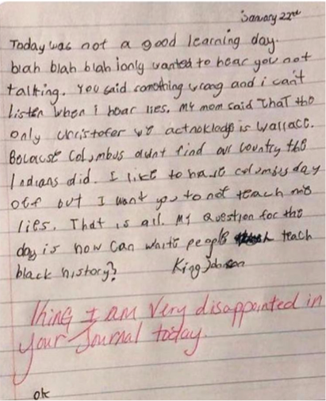
Using a Racial Equity Lens
Working in your breakout group, identify and discuss how internalized, interpersonal, institutional, and/or structural racism might be manifesting?
‹#›
Notes:
https://docs.google.com/document/d/1eZJlgofNHkeogf4vwGUY7mGsZlvdoHb2/edit?usp=sharing&ouid=110332262343343488709&rtpof=true&sd=true
True North EDI
Breakouts
Key Concepts Related to Race – Jonny
Key Concepts Related to Race: 30 minutes (1:30 – 2:00)
Breakouts (return to 4 breakout rooms previously assigned): King Johnson Letter, developing the skills needed later to unpack case studies in culture module
This is the process of building our capacity, and practicing where we’re able to name either the different levels or layers of systemic racism OR the social norms to engaging in dialogue around race or power or privilege
Screen share: Strategies to address different levels of racism: Nadia
“Today was not a good learning day. Blah, blah, blah. I only wanted to hear you not talking. You said something wrong and I can’t listen when I hear lies. My mom said that the only Christofer we acknowledge is Wallace. Because Columbus didn’t find our country, the Indians did. I like to have Columbus Day off, but I want you not to teach me lies. That is all. My question for the day is: How can white people teach black history?”
-personal/internalized - teaching history that removes bipoc voices/believing those things to be true
-interpersonal - The teachers response
-Institutional/structural - Curriculum, lack of multicultural educational

Slide 42
Strategies to Address Different Levels of Racism
Personal
Racism
Support groups, racial healing
Mentoring, counseling, and education
Interpersonal
Racism
Diversity trainings
Cross-cultural dialogues, dinners
Institutional
Racism
Changing policy and practices
Creating new institutions
Structural
Racism
Highlighting history, root causes
Challenging racist myths, ideologies
Challenging multiple institutions or addressing their interactions
‹#›

Slide 43

To Do On Your Own:
Engage with Racial Equity Concepts
Using the Race Forward Systems Analysis worksheet, identify how each dimension of racism – internal, interpersonal, institutional, and structural – shows up in your work.
Consider yourself or your organization.
‹#›
Notes:
Wrap-up and assignments for next Act: 10 minutes (2 – 2:10)
Assignments: Stay on 4 levels of racism – bring back examination of yourself or your organizational practice to address each level (race worksheet) Race Fwd worksheet: Steve puts hyperlink of document into chat

Slide 44
Systems Analysis: Understanding Racism in
Your Organization
Q1. What are examples of Internalized Racism (racism within individuals) that you notice at your organization? | Q2. What are examples of Interpersonal Racism (racism between individuals) that you notice at your organization?
Q3. What are examples of Institutional Racism (racism within institutions and systems of power)? What are ways in which your organization creates and maintains institutional racism? | Q4. What are examples of Structural Racism * (racism among institutions and across society)? What other aspects of culture, institutions or issue areas does your organization intersect with?
How did it feel to complete this analysis?
What questions emerged for you?
Do any remain unresolved?
‹#›
Notes:
https://docs.google.com/document/d/1YXtVdQPDjcJT2ygoYg_jIPXHxRUF2Tjg0MCX58ZlMro/edit?usp=sharing
Wrap-up and assignments for next Act: 10 minutes (2 – 2:10)
Assignments: Stay on 4 levels of racism – bring back examination of yourself or your organizational practice to address each level (race worksheet) Race Fwd worksheet: Steve puts hyperlink of document into chat
How did it feel to complete this analysis?
What questions emerged for you?
Do any remain unresolved?

Slide 45

An Offering to Carry Forward from Today
‹#›
Notes:
Black Futures: An Ode to Freedom Summer on Vimeo
True North EDI
Wrap-up and assignments for next Act: 10 minutes (2 – 2:10)
Steve plays video in final wrap-up
Freedom dreaming: Dr. Robin D. G. Kelley in his book, Freedom Dreams: The Black Radical Imagination (2003)
“Without new visions, we don’t know what to build, only what to knock down. We not only end up confused, rudderless and cynical, but we forget that making a revolution is not a series of clever maneuvers and tactics, but a process that can and must transform us”
Freedom Dreaming means acknowledging and harnessing your own intrinsic power and expertise. Freedom Dreaming is about listening deeply while unlearning harmful ideologies and ideas.

Slide 46
Racial Equity in
Arts Funding Workshop
Online|May 15, 2024

Slide 47
Welcome!
‹#›
Notes:
Introduction: 30 minutes (12 – 12:30):
Welcome, intro facilitators + presenters, land acknowledgement (Share link: To learn more about Native land, https://native-land.ca/), community accountability (3 minutes): Eddie
Jam Board/Break out Groups: Introductory activity/Getting to know each other in small break-outs: (15 minutes): Cardozie
Screen share: Overview & goals (3 minutes): Nadia
Screen share: Group agreements (5 minutes): Nadia
Screen share: Overview of the day (3 minutes): Nadia

Slide 48
Land Acknowledgements
GIA is headquartered on the unceded land of the Lenape and Wappinger peoples.
We ask you to join in acknowledging the Lenape and Wappinger communities, their elders both past and present, as well as future generations.
This acknowledgement demonstrates a commitment to beginning the process of working to dismantle the ongoing legacies of settler colonialism.
Notes:
Eddie
GIA is headquartered on the unceded land of the Lenape and Wappinger peoples.
We ask you to join in acknowledging the Lenape and Wappinger communities, their elders both past and present, as well as future generations.
This acknowledgement demonstrates a commitment to beginning the process of working to dismantle the ongoing legacies of settler colonialism.

Slide 49
Presenters
Jonny Soto-Altrogge, Facilitator, True North EDI
Nadia Elokdah, VP & Director of Programs, Grantmakers in the Arts
Jaime Sharp, Program Manager, Grantmakers in the Arts
Eddie Torres, President & CEO, Grantmakers in the Arts
Notes:
NADIA
Initial introductions for the room go-around: name, organization, gender pronouns

Slide 50
What’s giving you energy?
‹#›
Notes:
NADIA

Slide 51
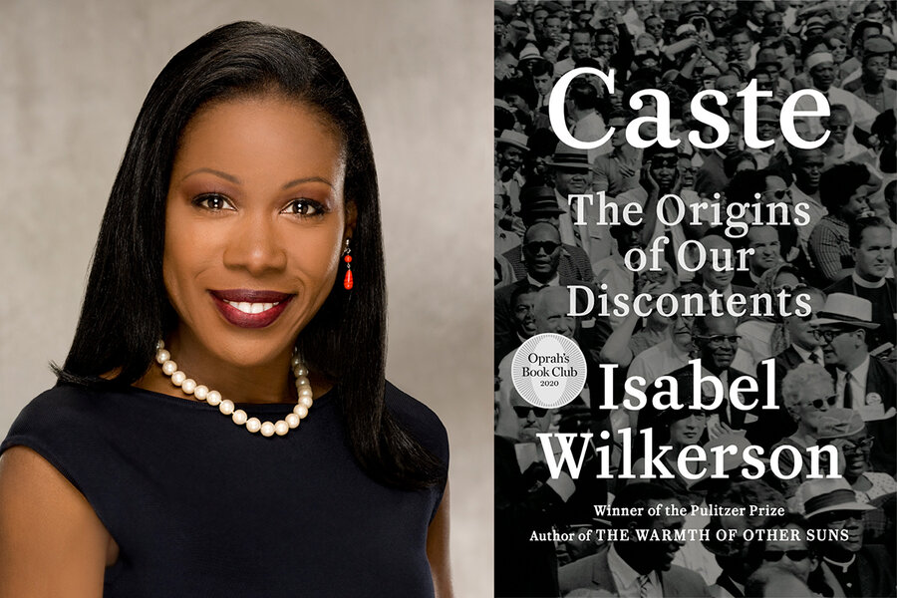

Slide 52
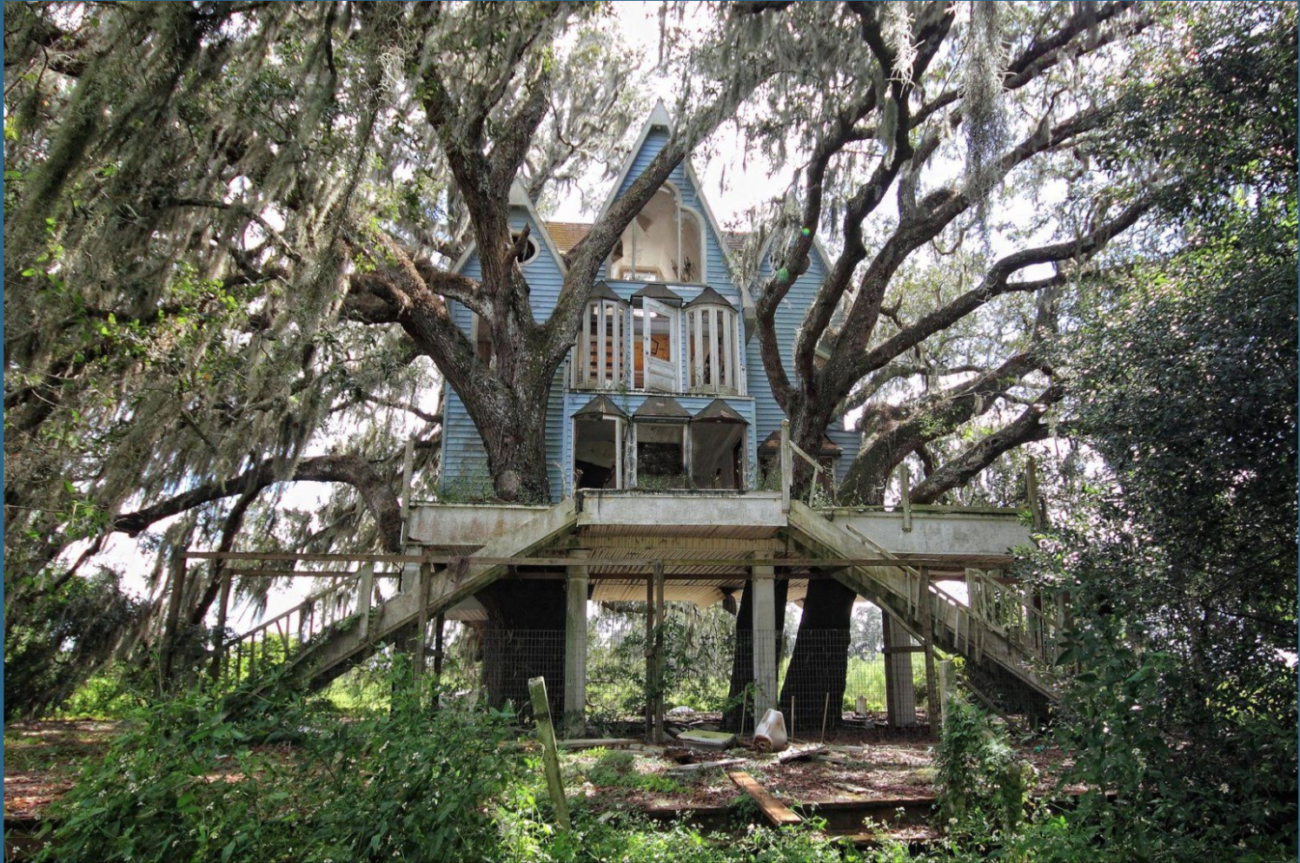
Notes:
Jonny - breakouts
https://docs.google.com/presentation/d/1NxVzcbWb3L3PTe9X2aI6YaR1kcJptGDyX7Vl6_v-0nE/edit?usp=sharing
The inspector trained his infrared lens onto a misshapen bow in the ceiling, an invisible beam of light searching the layers of lath to test what the eye could not see. This house was built generations ago, and I had noticed the slightest welt in a corner of plaster in a spare bedroom and chalked it up to idiosyncrasy. Over time, the welt in the ceiling became a wave that widened and bulged despite the new roof. It had been building beyond perception for years. An old house is its own kind of devotional, a dowager aunt with a story to be coaxed out of her, a mystery, a series of interlocking puzzles awaiting solution. Why is this soffit tucked into the southeast corner of an eave? What is behind this discolored patch of brick? With an old house, the work is never done, and you don’t expect it to be.
America is an old house. We can never declare the work over. Wind, flood, drought and human upheavals batter a structure that is already fighting whatever flaws were left unattended in the original foundation. When you live in an old house, you may not want to go into the basement after a storm to see what the rains have wrought. Choose not to look, however, at your own peril. The owner of an old house knows that whatever you are ignoring will never go away. Whatever is lurking will fester whether you choose to look or not. Ignorance is no protection from the consequences of inaction. Whatever you are wishing away will gnaw at you until you gather the courage to face what you would rather not see.
We’re going to lean into this metaphor and use this image of a dilapidating house as a representation of this metaphor, and in your breakouts discuss what you notice in this house in relation to the history of our nation. What might the pillars represent? Or perhaps the trees? Take 10 minutes to first introduce yourselves, then dive into what you see in this image.

Slide 53
Showing up today
‹#›
Notes:
NADIA

Slide 54
Group Agreements:
Occupy Brave Space
Commit to staying in your “Stretch Zone”
Honor selective vulnerability
Hold space for:
  a spectrum of experience in navigating these circumstances
  a spectrum of experience in relationship to the content
Acknowledge that everyone brings cultural knowledge to the discussion
Share the air / One mic
What is said stays, what is learned is leaves:
  Be prepared for facilitators to join you in breakout sessions for co-learning
Accept and expect a lack of closure
Source: YES! Jam Facilitator
‹#›
Notes:
Screen share: Group agreements (5 minutes): Nadia
Screen share: Overview of the day (3 minutes): Nadia
GIA to ask participants to respond to:
Occupy Brave Space
Comfort – Stretch – Panic Zones
Cardozie to ask group to respond to:
Selective Vulnerability
GIA to ask participants to respond to:
Other agreements to add?

Slide 55
Engagement Norms
Chat Norms
Feel free to eat, stretch, move.
We’d love to see you, but welcome you to turn off your camera if it is supportive for you.
Turn off your mic in the large group.
Please share your name when starting to speak so that everyone knows who is talking.
This is a learning space, please feel welcomed to share thoughts in progress and half-baked ideas!
Here’s how we encourage you to use the chat:
  Respond to a prompt
  Type “stack” or use raise hand function if you’d like to share something aloud or volunteer
  Share resources and tools
  Give each other affirmations ++
We may summarize ideas we see in the group chat aloud.
‹#›
Notes:
Screen share: Group agreements (5 minutes): Nadia
Screen share: Overview of the day (3 minutes): Nadia
GIA to ask participants to respond to:
Occupy Brave Space
Comfort – Stretch – Panic Zones
Cardozie to ask group to respond to:
Selective Vulnerability
GIA to ask participants to respond to:
Other agreements to add?

Slide 56
Overview of the Day
Will Do
Further unpack how racism operates and is sustained at multiple levels
Explore the role culture plays in systems and structures
Understand how grantmaking was created and exists within a highly racialized system
Begin to distill how structural racism operates in your work
Might Do
Understand how each of us is prepared to participate in anti-racist work
Won’t Do
Leave today with complete resolution
‹#›
Notes:
Screen share: Overview of the day (3 minutes): Nadia
Why lead with race? 20 minutes (12:40 – 1:10)
Barriers to Talking about Race: 30 minutes (1 – 1:30)
Key Concepts Related to Race: 30 minutes (1:30 – 2:00)
Wrap-up and assignments for next Act: 10 minutes (2 – 2:10)

Slide 57
How Culture Operates
(and is weaponized)
‹#›
Notes:
True North EDI
What things come to mind when you think of culture? – share in chat.
How culture is weaponized: 1 – 1:40
Screen share: Introducing White Supremacy Culture (WSC); how we are acculturated to bias; how we weaponize WSC (Kendi’s terminologies and specifically anti-racist): (1 – 1:10pm) Nadia
Screen share: Belief-based racism (from Ibram X. Kendi): segregationists, assimilationists, anti-racists: Nadia
Screen share: Shift from grantees’ processes to practices of funding organizations (chuck symphony example): Nadia
Screen share: Through culture lens, how WSC operates, example: Sherylynn
Case Studies of institutional racism, white supremacy culture, bias
Institutional analysis, Tema Okun, where do these white supremacy culture items come up in institution, sector, etc.
Culture is a bridge from systems to ourselves, our institutions. What are you doing to prevent racism and encourage anti-racism?

Slide 58
“Culture is the way that every brain makes sense of the world. That is why everyone, regardless of race or ethnicity, has a culture. Think of culture as software for the brain’s hardware. The brain uses cultural information to turn everyday happenings into meaningful events.”
-- Zaretta Hammond
What is culture?
‹#›
Notes:
True North EDI
How culture is weaponized:
If we talked about processing information, we process about 40 bits of information a second, consciously. And in that same second, process 11 million bits of information unconsciously. So, the unconscious is doing all the work…It sorts. It creates associations, and it fills in gaps.
How culture is weaponized: 1 – 1:40
Screen share: Introducing White Supremacy Culture (WSC); how we are acculturated to bias; how we weaponize WSC (Kendi’s terminologies and specifically anti-racist): (1 – 1:10pm) Nadia
Screen share: Belief-based racism (from Ibram X. Kendi): segregationists, assimilationists, anti-racists: Nadia
Screen share: Shift from grantees’ processes to practices of funding organizations (chuck symphony example): Nadia
Screen share: Through culture lens, how WSC operates, example: Sherylynn
Case Studies of institutional racism, white supremacy culture, bias
Institutional analysis, Tema Okun, where do these white supremacy culture items come up in institution, sector, etc.
Culture is a bridge from systems to ourselves, our institutions. What are you doing to prevent racism and encourage anti-racism?

Slide 59
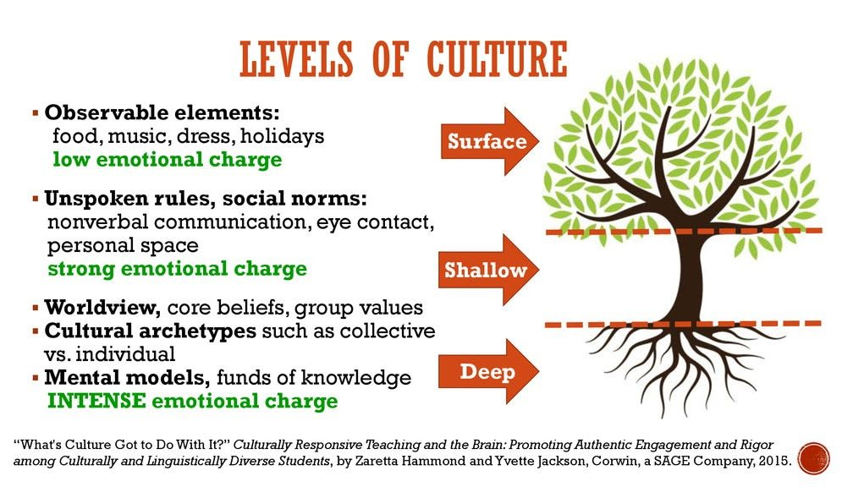
What is culture?
‹#›
Notes:
True North EDI
How culture is weaponized:
If we talked about processing information, we process about 40 bits of information a second, consciously. And in that same second, process 11 million bits of information unconsciously. So, the unconscious is doing all the work…It sorts. It creates associations, and it fills in gaps.
How culture is weaponized: 1 – 1:40
Screen share: Introducing White Supremacy Culture (WSC); how we are acculturated to bias; how we weaponize WSC (Kendi’s terminologies and specifically anti-racist): (1 – 1:10pm) Nadia
Screen share: Belief-based racism (from Ibram X. Kendi): segregationists, assimilationists, anti-racists: Nadia
Screen share: Shift from grantees’ processes to practices of funding organizations (chuck symphony example): Nadia
Screen share: Through culture lens, how WSC operates, example: Sherylynn
Case Studies of institutional racism, white supremacy culture, bias
Institutional analysis, Tema Okun, where do these white supremacy culture items come up in institution, sector, etc.
Culture is a bridge from systems to ourselves, our institutions. What are you doing to prevent racism and encourage anti-racism?

Slide 60
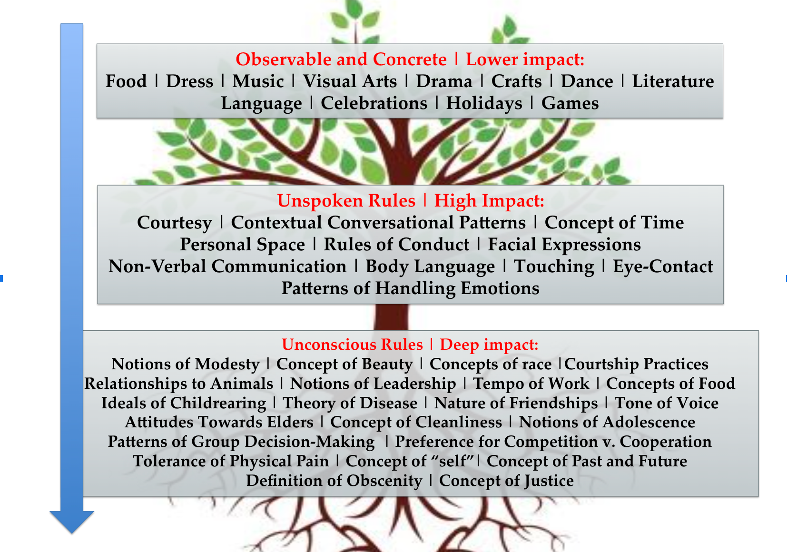
What is culture?
‹#›
Notes:
True North EDI
How culture is weaponized:
If we talked about processing information, we process about 40 bits of information a second, consciously. And in that same second, process 11 million bits of information unconsciously. So, the unconscious is doing all the work…It sorts. It creates associations, and it fills in gaps.
How culture is weaponized: 1 – 1:40
Screen share: Introducing White Supremacy Culture (WSC); how we are acculturated to bias; how we weaponize WSC (Kendi’s terminologies and specifically anti-racist): (1 – 1:10pm) Nadia
Screen share: Belief-based racism (from Ibram X. Kendi): segregationists, assimilationists, anti-racists: Nadia
Screen share: Shift from grantees’ processes to practices of funding organizations (chuck symphony example): Nadia
Screen share: Through culture lens, how WSC operates, example: Sherylynn
Case Studies of institutional racism, white supremacy culture, bias
Institutional analysis, Tema Okun, where do these white supremacy culture items come up in institution, sector, etc.
Culture is a bridge from systems to ourselves, our institutions. What are you doing to prevent racism and encourage anti-racism?

Slide 61
“The interesting stuff about the unconscious, the unconscious is social. The unconscious is very, very fast. The conscious is very slow.
- - -
So, often times we think the way that we actually connect is to not see that we have differences, and we're afraid of difference at the conscious level, and so we say we all have to be the same. And we aren't all the same in terms of our human value…human expression. And so, while the conscious is running away from our different expressions, the unconscious is noticing, categorizing, and often times reflecting the response that society has said about those differences.”
-- john a powell
What is culture?
‹#›
Notes:
Nadia
Connect to frog/fish cartoon
Connect to 4 layers - how we understand
How culture is weaponized:
If we talked about processing information, we process about 40 bits of information a second, consciously. And in that same second, process 11 million bits of information unconsciously. So, the unconscious is doing all the work…It sorts. It creates associations, and it fills in gaps.
How culture is weaponized: 1 – 1:40
Screen share: Introducing White Supremacy Culture (WSC); how we are acculturated to bias; how we weaponize WSC (Kendi’s terminologies and specifically anti-racist): (1 – 1:10pm) Nadia
Screen share: Belief-based racism (from Ibram X. Kendi): segregationists, assimilationists, anti-racists: Nadia
Screen share: Shift from grantees’ processes to practices of funding organizations (chuck symphony example): Nadia
Screen share: Through culture lens, how WSC operates, example: Sherylynn
Case Studies of institutional racism, white supremacy culture, bias
Institutional analysis, Tema Okun, where do these white supremacy culture items come up in institution, sector, etc.
Culture is a bridge from systems to ourselves, our institutions. What are you doing to prevent racism and encourage anti-racism?

Slide 62
Dominant Culture
Sets Whiteness as the dominant, privileged group; as the norm or default culture.
Impacts how non-dominant or non-privileged groups are understood, viewed, and treated by others.
Compares and judges non-dominant or non-privileged groups to the default.
Does not leave room for multiple, cultural ways of being to be treated or perceived equally.
‹#›
Notes:
Nadia
How culture is weaponized:
Share with participants:
While one could say that being “open” to different cultures is the answer to conflict, we must recognize that in our work we have to consider the part that power and ultimately inequity can play
How culture is weaponized: Screen share: Introducing White Supremacy Culture (WSC); how we are acculturated to bias; how we weaponize WSC (Kendi’s terminologies and specifically anti-racist): (1 – 1:10pm) Nadia
Screen share: Belief-based racism (from Ibram X. Kendi): segregationists, assimilationists, anti-racists: Nadia
Screen share: Shift from grantees’ processes to practices of funding organizations (chuck symphony example): Nadia
Screen share: Through culture lens, how WSC operates, example: Sherylynn
Case Studies of institutional racism, white supremacy culture, bias
Institutional analysis, Tema Okun, where do these white supremacy culture items come up in institution, sector, etc.
Culture is a bridge from systems to ourselves, our institutions. What are you doing to prevent racism and encourage anti-racism?

Slide 63
Elemental Design: Where are we operating?
‹#›
Notes:
Jonny & Sherylynn

Slide 64


Elemental Design
Elemental Design offers us a framework rooted in balance and community (and in this case ‘organizational’) health
It allows us a way to unfold what’s present as well as design a possible future for ourselves
Requires us to consider the whole self as well as the whole organization

Slide 65
Elemental Design
Spirit |  | Physical
Emotional |  | Mental/Intellectual
Notes:
https://drive.google.com/file/d/1QiYPSb3dim2U6PI7uKSH1H__SbKVa9hE/view?usp=sharing

Slide 66
Elemental Design
Spirit Acknowledges and centers the spirit Considers the relationship between the self and something greater than or outside the self Values the interconnectedness of all things Emphasizes connection and interdependence |  | Physical Acknowledges and centers the body Considers the physical space/environment/earth Values the bodies of those present and honors the reality of those bodies in this world Emphasizes naming and presence
Emotional Acknowledges and centers the affect Considers feelings and emotions Values the lived experience of the unique people in the space Emphasizes storytelling and sharing |  | Mental/Intellectual Acknowledges the mind and the intellect Considers knowledge, understanding, data, systems, etc Values exchange and debate Emphasizes explaining
Notes:
On a surface level, the mental body is your thoughts. On a deeper level, it is the domain of your beliefs, desires, values, and goals. Beliefs are opinions and convictions that we hold as being true without having immediate proof. Values represent what we hold internally as most important in an area of life. Values and beliefs can come from thoughts that were formed very early in childhood.
What area do you feel like you function in the most? How does it benefit you? How might it harm you?
Where does your organization function the most? Which of these does your org place the highest value upon?
There all interconectedd, it’s a circle. It’s a ven diagram though and we rarely funciton in one. What’s it mean when we only function in one? Whats missing, what’s at risk? We seek balance.
https://drive.google.com/file/d/1QiYPSb3dim2U6PI7uKSH1H__SbKVa9hE/view?usp=sharing

Slide 67
Understanding White Supremacy Culture
in our Work
‹#›
Notes:
Jonny & Jaime

Slide 68
Understanding White Supremacy Culture in our Work
Think about your experience with, or what you know of, the U.S. education system. What are the “American values” that are taught explicitly?
What values are not made visible or taught about explicitly?
‹#›
Notes:
Jaime and Johnny
True North EDI
Understanding White Supremacy Culture
Important to name that each of the culture’s we belong to are not inherently wrong,

Slide 69
White Supremacy Culture [Tema Okun, dRworks]
The document, White Supremacy Culture, is not meant to
be synonymous with “things white people do” (though it can certainly overlap). Rather, it speaks to cultural ways of being
in American organizations and institutions (that we all have the potential and, often, the inclination, to subscribe to),
that reflect the colonized practices and belief systems that we’ve inherited from our “founding” as a country. It is meant to point to structures and cultural practices designed to maintain the established power structure.
‹#›
Notes:
Jaime and Johnny
True North EDI
Understanding White Supremacy Culture
Kenneth Jones

Slide 70
White Supremacy Culture [Tema Okun, dRworks]
When reading it, it’s important for your own development to think of how you — as someone with a sphere of influence — might be producing/reproducing these values and more importantly, how you might disrupt and counter them.
White supremacy culture is often invisible, the ability to identify it is a skill that can lead to the disruption of inequitable and non-inclusive environments, and an opportunity to reimagine them in more equitable and inclusive ways.
‹#›
Notes:
True North EDI
Understanding White Supremacy Culture

Slide 71
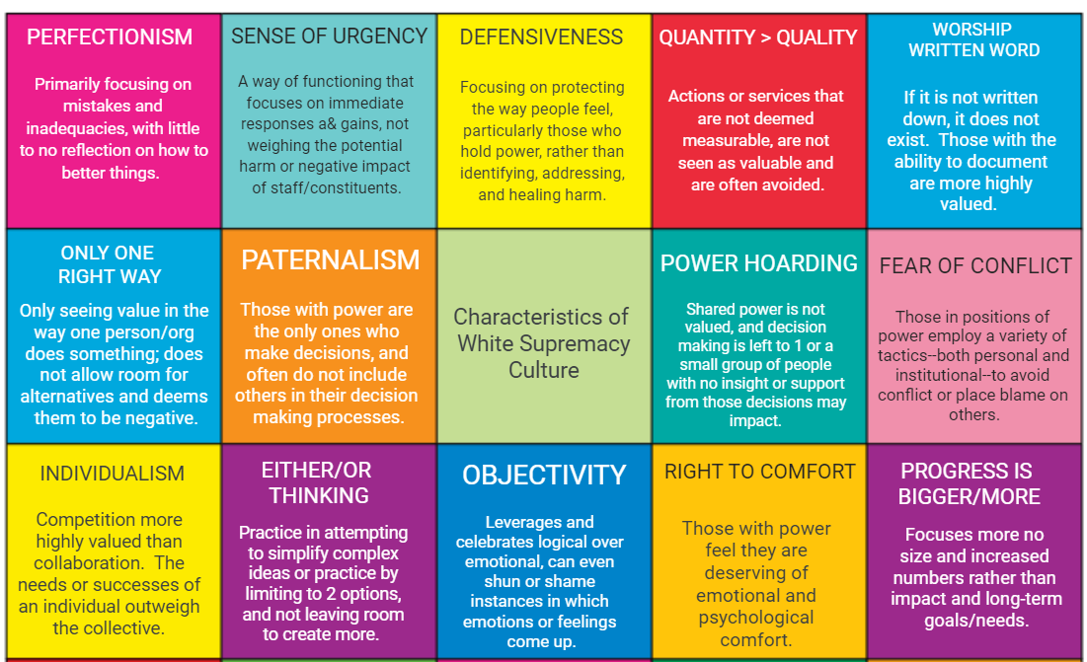
White Supremacy Culture [Tema Okun, dRworks]
‹#›
Notes:
**Jaime
Dive deeper into 4 or 5 here; curate for what we know comes up the most! (perfectionism, sense of urgency, quantity over quality, only one right way, paternalism)
Jam board: https://jamboard.google.com/d/1tZTTRhB8NZWJqv-AxnxFesMnYQvXvrU-fSPTQeFh6Lo/viewer?f=0

Slide 72
White Supremacy Culture [Tema Okun, dRworks]
Which characteristic have you seen show up most in your career?
Go to www.menti.com and use the code 3724 6383
‹#›
Notes:
Jaime
Understanding White Supremacy Culture
Mentimeter - https://www.menti.com/alcorx8c48kc - Code 6819 7942
https://docs.google.com/presentation/d/1HFsxUynqRdL1wWaGKtI70lWG1fxQLl_uydR4g5hoYaA/edit?usp=sharing

Slide 73
White Supremacy Culture [Tema Okun, dRworks]
In your breakout group:
Share about what you put in the mentimeter.
Discuss what replacement characteristics could be.
‹#›
Notes:
(Not sure if folks are fully ready with thinking about replacement characteristics yet)
Sherylynn
Understanding White Supremacy Culture
Jamboard: https://jamboard.google.com/d/1tZTTRhB8NZWJqv-AxnxFesMnYQvXvrU-fSPTQeFh6Lo/viewer?f=0
Alternatives to WSC

Slide 74
Elemental Design
Spirit Acknowledges and centers the spirit Considers the relationship between the self and something greater than or outside the self Values the interconnectedness of all things Emphasizes connection and interdependence |  | Physical Acknowledges and centers the body Considers the physical space/environment/earth Values the bodies of those present and honors the reality of those bodies in this world Emphasizes naming and presence
Emotional Acknowledges and centers the affect Considers feelings and emotions Values the lived experience of the unique people in the space Emphasizes storytelling and sharing |  | Mental/Intellectual Acknowledges the mind and the intellect Considers knowledge, understanding, data, systems, etc Values exchange and debate Emphasizes explaining
Notes:
Where are you experiencing this last discussion?
On a surface level, the mental body is your thoughts. On a deeper level, it is the domain of your beliefs, desires, values, and goals. Beliefs are opinions and convictions that we hold as being true without having immediate proof. Values represent what we hold internally as most important in an area of life. Values and beliefs can come from thoughts that were formed very early in childhood.
What area do you feel like you function in the most? How does it benefit you? How might it harm you?
Where does your organization function the most? Which of these does your org place the highest value upon?
There all interconectedd, it’s a circle. It’s a ven diagram though and we rarely funciton in one. What’s it mean when we only function in one? Whats missing, what’s at risk? We seek balance.
https://drive.google.com/file/d/1QiYPSb3dim2U6PI7uKSH1H__SbKVa9hE/view?usp=sharing

Slide 75
Racial Equity in Arts Funding
‹#›
Notes:
Eddie

Slide 76
Racial Equity in Funding
Investment in policies, practices, and actions that produce equitable access, power, and outcomes for people and communities of color.
‹#›
Notes:
2pm: Eddie: Racial Equity in Arts Funding – goal is to build the analysis muscle, similar to the King Johnson letter approach:
How racism operates in institutions and systems of grantmaking:
NOTE: Racial inequity in funding generally. Grantmakers for Effective Organizations here.
Kendi & Haney López (frameworks) History of arts funding as adopted from private and govt philanthropy: Eddie
Strategic Racism (from Ian Haney López): money, status, power: Eddie
These forms of racism are maintained passively: Eddie
Helicon Collaborative Report data and follow up from Medium: Sherylynn
Root Causes of Funding Inequity: Eddie
Policy Shapes Racial Outcomes: Eddie
De-coding Racial Bias - language to avoid identifying/addressing race (GIA pulls content to include in ppt): Sherylynn

Slide 77
Arts Funding in the Context of Race
An organization of color or BIPOC organization or ALAANA (African, Latinx, Asian, Arab, Native American) organization is defined by:
  Self-determination;
  The organization’s primary mission, intentions, and practices are BY, FOR, and ABOUT artists, cultures, and communities of color;
  The intention of the organization to perpetuate, promote, and present art that is representative of a culture, a people, and/or is given form by those artists; and
  The organization is not a charity construct (i.e. “We’re helping those underprivileged people.”)
‹#›
Notes:
Racial Equity in Arts Funding – EDDIE
An ALAANA (Asian, Latinx, African, Arab, Native American) organization or organization of color is…
An organization whose primary mission, intentions and practices are BY, FOR and ABOUT artists, cultures and communities of color
When we say “FOR” we are referring to the intention of the organization to perpetuate, promote and present art that is representative of an ALAANA culture and people and/or is given form by ALAANA artists
“For” does NOT refer to a charity construct, “We’re helping those underprivileged people”
“For” refers to self-determination

Slide 78
Arts Funding in the Context of Race
Largest predominantly White nonprofit theater companies:
$50-60M/year
Largest predominantly Black nonprofit theater company:
$3.5M/year
Largest predominantly Latinx nonprofit theater company:
$2.5M/year
‹#›
Notes:
Racial Equity in Arts Funding – EDDIE
Arts Funding in the Context of Race
Largest predominantly white nonprofit theatre companies in America: budgets between $50-$60 million
The largest predominantly African-American theatre company: budget of $3.5 million.
Largest predominantly Latino company: $2.5 million
An ALAANA (Asian, Latinx, African, Arab, Native American) organization is…
An organization whose primary mission, intentions and practices are BY, FOR and ABOUT ALAANA artists, cultures and communities
When we say “FOR” we are referring to the intention of the organization to perpetuate, promote and present art that is representative of an ALAANA culture and people and/or is given form by ALAANA artists
“For” does NOT refer to a charity construct, “We’re helping those underprivileged people”
“For” refers to self-determination

Slide 79
Arts Funding in the Context of Race
Increasing awareness of diversity, equity, and inclusion issues
2% of all cultural institutions receive nearly 60% of foundation giving in the arts
Inequality up 5% from a decade ago
33% of U.S. residents are people of color while only 4% of cultural philanthropy goes to organizations of color
Source: “Not Just Money: Equity Issues in Arts Philanthropy,” Helicon Collaborative, 2017
‹#›
Notes:
EDDIE: Racial Equity in Arts Funding – goal is to build the analysis muscle, similar to the King Johnson letter approach: 45 minutes (1:25 – 2:10)
How racism operates in institutions and systems of grantmaking:
NOTE: Racial inequity in funding generally. Grantmakers for Effective Organizations here.
Kendi & Haney López (frameworks) History of arts funding as adopted from private and govt philanthropy: Eddie
Strategic Racism (from Ian Haney López): money, status, power: Eddie
These forms of racism are maintained passively: Eddie
Helicon Collaborative Report data and follow up from Medium: Sherylynn
Root Causes of Funding Inequity: Eddie
Policy Shapes Racial Outcomes: Eddie
De-coding Racial Bias - language to avoid identifying/addressing race (GIA pulls content to include in ppt): Sherylynn

Slide 80
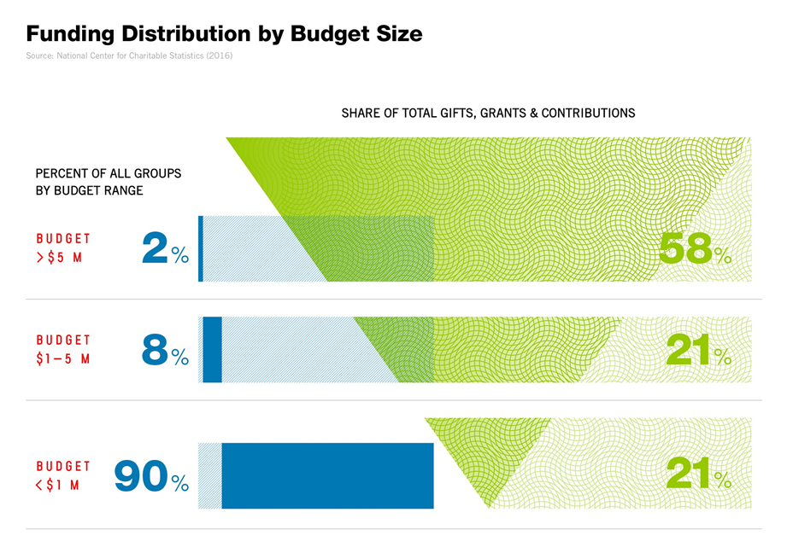
Arts Funding in the Context of Race
Source: “Not Just Money: Equity Issues in Arts Philanthropy,” Helicon Collaborative, 2017
‹#›
Notes:
Racial Equity in Arts Funding – EDDIE
As talk of “DEI” increases, funding to communities of color decreases
Arts foundations and nonprofit leaders are increasingly aware of diversity, equity and inclusion issues in the nonprofit sector.
Despite this, 2% of all cultural institutions receive nearly 60% of foundation giving in the arts, up 5% from a decade ago.
In a country where 33% of residents are people of color, just 4% of cultural philanthropy goes to organizations of color.

Slide 81
Arts Funding in the Context of Race
Root Causes of Funding Inequity
  The practices of high-net-worth individual donors
  Racialized cultural hierarchy
  Leverage
  Moneyed networks
  Enshrined in giving practices of foundations and government agencies
‹#›
Notes:
Racial Equity in Arts Funding – Eddie
Institutional cultural philanthropy’s valuing of an organization’s ability to leverage a grant favors organizations who have wealthy individuals in their networks.
In the U.S., institutional cultural philanthropy copied the practices of high-net-worth individual donors.
These donors had (and have) access to other wealthy donors.
These donors were (and are) able to enhance their social capital through their giving.
This rewarded institutions in their moneyed networks, instead of organizations in low-income communities.
And it’s a practice that often remains enshrined in giving practices of foundations and government agencies.

Slide 82
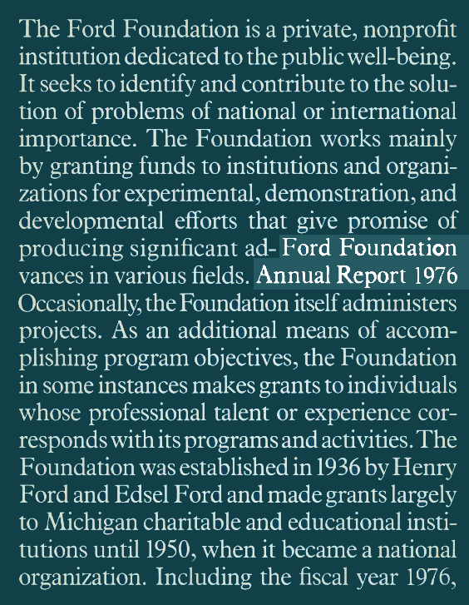


Arts Policy Shapes Racial Outcomes
Ford Foundation
National Endowment for the Arts
Expansion Arts
‹#›
Notes:
Racial Equity in Arts Funding – Eddie
A successful nonprofit model promoted by the Ford Foundation from 1957-1976 established leverage as a criteria for a successful grant and a successful organization. Matches of foundation funding with local funding, $1 to $1, $2 to $1, and on became the norm.
One of the unintended consequences of this practice was need for non-profits to develop boards as fundraisers with wealth and access to those with it.
This negatively impacted those organizations led by low-income people.
NEA’s Expansion Arts program which funded “the other” from 1971-1996 which created the Jazz Masters program and traditional arts foci and NEA Local Arts Agency program, founded in 1984 was created to help cities be more supportive of community arts including ALAANA orgs and artists. These program budgets were tiny compared to the disciplines and in no way allowed for equity funding and growth of non-Eurocentric art forms. In “The National Endowment for the Arts: A History” published in 2009, it states, “The National Endowment for the Arts introduced the Expansion Arts Program to honor the nation’s cultural diversity. Vantile Whitfield…led the NEA’s initiative to expand arts resources beyond the familiar opera, orchestra, ballet and museum settings.” The dollars that funded this program were inadequate to meet that mission in any substantive way.
Local Arts Agency program (1984) also under-funded in comparison with discipline programs.
Encouraging and funding organizational endowments for established organizations with the resources to fundraise for operating as well as endowment capital.

Slide 83
Arts Funding in the Context of Race
Where do these practices show up now?
  Racialized cultural hierarchy
  Leverage
  Moneyed networks
  Enshrined in giving practices of foundations and government agencies
How do you interrupt them?
‹#›
Notes:
Racial Equity in Arts Funding – Eddie
Institutional cultural philanthropy’s valuing of an organization’s ability to leverage a grant favors organizations who have wealthy individuals in their networks.
In the U.S., institutional cultural philanthropy copied the practices of high-net-worth individual donors.
These donors had (and have) access to other wealthy donors.
These donors were (and are) able to enhance their social capital through their giving.
This rewarded institutions in their moneyed networks, instead of organizations in low-income communities.
And it’s a practice that often remains enshrined in giving practices of foundations and government agencies.

Slide 84
Policies Precede Beliefs (Ibram X. Kendi)
Anti-racism –
Work to eradicate the racialized outcomes of institutional and social systems and structures
Redesigning or replacing those systems and structures
Acknowledgement that the culture of BIPOC folks in the U.S. are different from White folks in the U.S.
Respect for BIPOC’s cultural differences as just that – different, not better or worse
‹#›
Notes:
Racial Equity in Arts Funding – Eddie
A successful nonprofit model promoted by the Ford Foundation from 1957-1976 established leverage as a criteria for a successful grant and a successful organization. Matches of foundation funding with local funding, $1 to $1, $2 to $1, and on became the norm.
One of the unintended consequences of this practice was need for non-profits to develop boards as fundraisers with wealth and access to those with it.
This negatively impacted those organizations led by low-income people.
NEA’s Expansion Arts program which funded “the other” from 1971-1996 which created the Jazz Masters program and traditional arts foci and NEA Local Arts Agency program, founded in 1984 was created to help cities be more supportive of community arts including ALAANA orgs and artists. These program budgets were tiny compared to the disciplines and in no way allowed for equity funding and growth of non-Eurocentric art forms. In “The National Endowment for the Arts: A History” published in 2009, it states, “The National Endowment for the Arts introduced the Expansion Arts Program to honor the nation’s cultural diversity. Vantile Whitfield…led the NEA’s initiative to expand arts resources beyond the familiar opera, orchestra, ballet and museum settings.” The dollars that funded this program were inadequate to meet that mission in any substantive way.
Local Arts Agency program (1984) also under-funded in comparison with discipline programs.
Encouraging and funding organizational endowments for established organizations with the resources to fundraise for operating as well as endowment capital.

Slide 85
Elemental Design
Spirit Acknowledges and centers the spirit Considers the relationship between the self and something greater than or outside the self Values the interconnectedness of all things Emphasizes connection and interdependence |  | Physical Acknowledges and centers the body Considers the physical space/environment/earth Values the bodies of those present and honors the reality of those bodies in this world Emphasizes naming and presence
Emotional Acknowledges and centers the affect Considers feelings and emotions Values the lived experience of the unique people in the space Emphasizes storytelling and sharing |  | Mental/Intellectual Acknowledges the mind and the intellect Considers knowledge, understanding, data, systems, etc Values exchange and debate Emphasizes explaining
Notes:
On a surface level, the mental body is your thoughts. On a deeper level, it is the domain of your beliefs, desires, values, and goals. Beliefs are opinions and convictions that we hold as being true without having immediate proof. Values represent what we hold internally as most important in an area of life. Values and beliefs can come from thoughts that were formed very early in childhood.
What area do you feel like you function in the most? How does it benefit you? How might it harm you?
Where does your organization function the most? Which of these does your org place the highest value upon?
There all interconectedd, it’s a circle. It’s a ven diagram though and we rarely funciton in one. What’s it mean when we only function in one? Whats missing, what’s at risk? We seek balance.
https://drive.google.com/file/d/1QiYPSb3dim2U6PI7uKSH1H__SbKVa9hE/view?usp=sharing

Slide 86
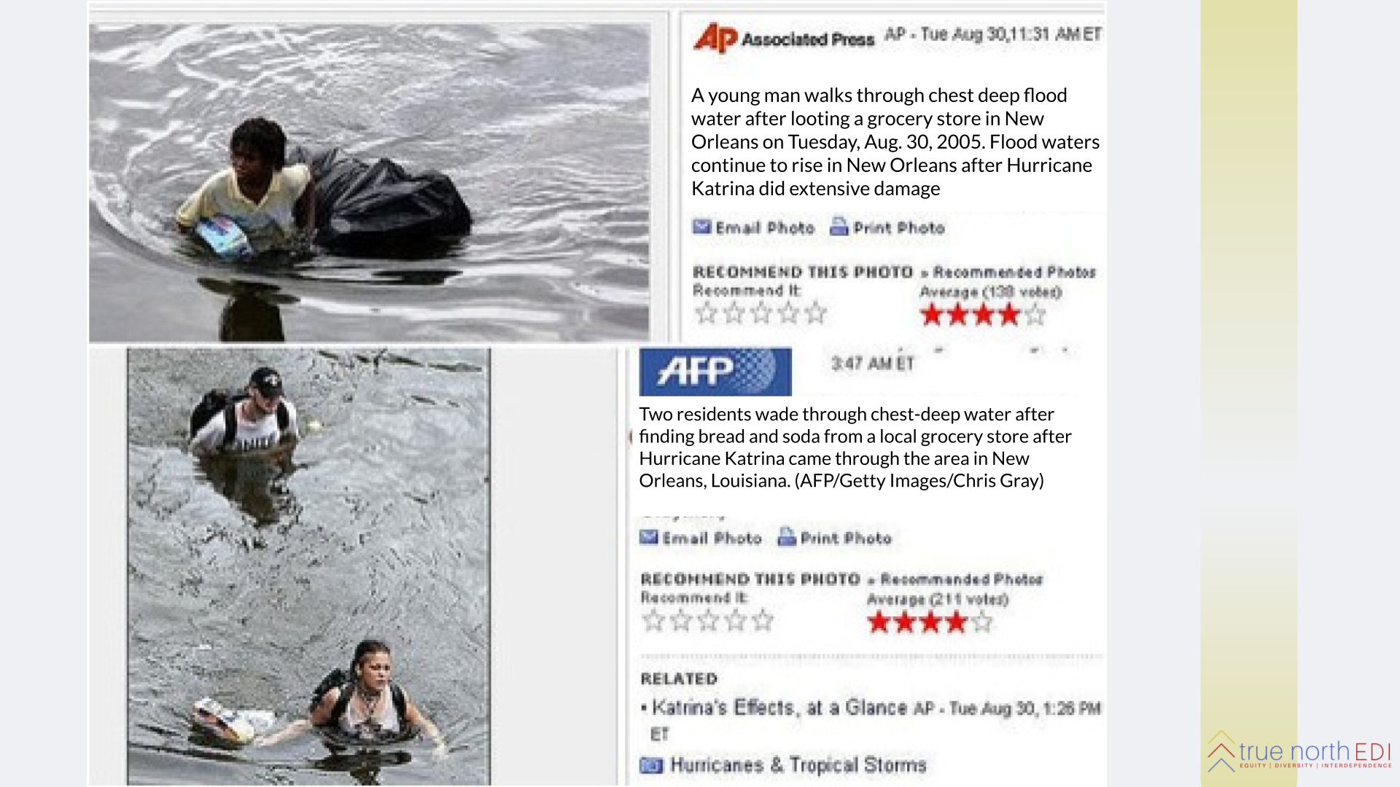
‹#›
Notes:
(wondering about using degraw hacket slides here)
1:50-2:45pm: Racial Equity in Arts Funding –sherylynn
TRIGGER WARNING
We regularly see bias in media/daily language. See example of implicit bias language in news posts. (remember jonny to grab other associated press image for future)
What comes up for you?
How might we correct/interrupt this bias?
Post Hurricane Katrina media coverage provides a particularly stark example in which the Black/ White frame reinforces implicit bias that pits Black against White to the detriment of building unity and community in a time of collective need. Yahoo News published two similar photographs on the same day, using racialized terms to describe the images:
“A young [Black] man walks through chest deep flood after looting a grocery store in New Orleans”
“Two [White] residents wade through chest-deep water after finding bread and soda from a local grocery store after Hurricane Katrina”

Slide 87
De-Coding Racial Bias in Daily Language
What you hear: _____________
Ways to interpret: ___________
What implicit bias can you identify and how might you attempt to interrupt this institutional practice?
‹#›
Notes:
1:50-2:45pm: Racial Equity in Arts Funding – SHERYLYNN
We regularly see bias in media/daily language. See example of implicit bias language in news posts. (remember jonny to grab other associated press image for future)
What comes up for you?
How might we correct/interrupt this bias?
Post Hurricane Katrina media coverage provides a particularly stark example in which the Black/ White frame reinforces implicit bias that pits Black against White to the detriment of building unity and community in a time of collective need. Yahoo News published two similar photographs on the same day, using racialized terms to describe the images:
“A young [Black] man walks through chest deep flood after looting a grocery store in New Orleans”
“Two [White] residents wade through chest-deep water after finding bread and soda from a local grocery store after Hurricane Katrina”

Slide 88
Decoding, Interrupting, & Replacing Racial Bias in Arts Funding Language & Practice
Choose a breakout group to join where you’ll discuss implicit bias in the following terms?
Rewarding organizations’ ability to “leverage a grant”
Focus on supporting “quality”
Focus on supporting the “mainstream”
Marginalizing “culturally-specific” organizations, artists & forms
‹#›
Notes:
https://docs.google.com/document/d/1vulMhCJprHV0Ctcz9kJfemkzyX-4asjL/edit?usp=sharing&ouid=110332262343343488709&rtpof=true&sd=true
Sherylynn introduces; Nadia handles breakouts; Afterward Nadia debriefs

Slide 89
Decoding, Interrupting, & Replacing Racial Bias in Arts Funding Language & Practice
How might you respond to and interrupt biased institutional practices that are inherited from history and revealed in language?
‹#›
Notes:
https://docs.google.com/document/d/1vulMhCJprHV0Ctcz9kJfemkzyX-4asjL/edit?usp=sharing&ouid=110332262343343488709&rtpof=true&sd=true
Sherylynn introduces; Nadia handles breakouts; Afterward Nadia debriefs

Slide 90
Assignments and Next Steps
‹#›
Notes:
Eddie
Start to think about working collectively,
GIA's racial equity research to review prior to next module Grantmakers in the Arts Racial Equity Case Studies (2017) (giarts.org)

Slide 91
Racial Equity in
Arts Funding Workshop
Online| May 22, 2024
Notes:
Assignments in advance of participation:
Watch the August 2018 Race Forward webinar on race on GIA’s website
Consider a possible vision of racial equity that could be manifest in your organization or entity in 25 years and bring to the workshop
Consider the challenges you’ve experienced related to racial equity in your organization or agency
Consider efforts or interventions solutions to these kinds of challenges you have executed, experienced, observed or heard of
Questions to share while they watch the webinar:
How does your organization or agency contribute to a culture of silence?
Interrupt a culture of silence?
What are some examples of organizational strategies (communications, external engagement etc) you’re currently using to interrupt a culture a of silence ?
8:30: Food and coffee
Day 1: 9am – 5:30pm
9:00 – 9:10: Welcome from hosts and facilitator introductions
9:15 – 9:25: Participant intros with “story huddle”
9:25 – 9:27: Overview and goals
9:27 – 9:35: Community agreements
9:35 – 9:40: Overview of day
9:40 – 9:55: Questions and observations on the webinar
Welcomes from: Eddie from GIA, local funders and RF
Understand key concepts related to structural racism.
Explore the expression of structural racism in the arts sector.
Identify opportunities for further learning and action to address structural and institutional racism in your organization or agency.
Explore how arts funders can shift resources or find new resources to support artists of color/African, Latinx, Asian, Arab and Native American (ALAANA) artists and arts organizations of people and communities of color.
Interventions or strategies, rather than solutions?
Option to have informal drinks and mingling instead

Slide 92
Welcome!
‹#›
Notes:
Introduction: 30 minutes (12 – 12:30):
Welcome, intro facilitators + presenters, land acknowledgement (Share link: To learn more about Native land, https://native-land.ca/), community accountability (3 minutes): Eddie
Jam Board/Break out Groups: Introductory activity/Getting to know each other in small break-outs: (15 minutes): Cardozie
Screen share: Overview & goals (3 minutes): Nadia
Screen share: Group agreements (5 minutes): Nadia
Screen share: Overview of the day (3 minutes): Nadia

Slide 93
Land Acknowledgement
GIA is headquartered on the unceded land of the Lenape and Wappinger peoples.
We ask you to join in acknowledging the Lenape and Wappinger communities, their elders both past and present, as well as future generations.
This acknowledgement demonstrates a commitment to beginning the process of working to dismantle the ongoing legacies of settler colonialism.
Notes:
Eddie
GIA is headquartered on the unceded land of the Lenape and Wappinger peoples.
We ask you to join in acknowledging the Lenape and Wappinger communities, their elders both past and present, as well as future generations.
This acknowledgement demonstrates a commitment to beginning the process of working to dismantle the ongoing legacies of settler colonialism.

Slide 94
Presenters
Jonny Soto-Altrogge, Facilitator, True North EDI
Denise Brown, Executive Director, Leeway Foundation
Nadia Elokdah, VP & Director of Programs, Grantmakers in the Arts
Tariana Navas-Nieves, Deputy Director, Denver Art & Venues
Jaime Sharp, Program Manager, Grantmakers in the Arts
Eddie Torres, President & CEO, Grantmakers in the Arts
Notes:
NADIA
Initial introductions for the room go-around: name, organization, gender pronouns

Slide 95
Lay It on the Line
‹#›
Notes:
Jonny

Slide 96
I feel most restored/relaxed in
which space?
‹#›
Notes:
I feel most restored/relaxed in which space?
MOUNTAIN
BEACH
HOME
TRAVELING
AMONG FRIENDS

Slide 97
I feel most aligned with which element?
‹#›
Notes:
I feel most aligned with which element?
EARTH
WIND
FIRE
WATER

Slide 98
I feel confident that I have the skills, knowledge, and motivation I need to lead for racial equity.
‹#›
Notes:
I feel confident that I have the skills, knowledge, and motivation I need to lead for racial equity.

Slide 99
I feel safe and supported in raising issues about racial equity within
my professional environment.
‹#›
Notes:
I feel safe and supported in raising issues about racial equity within my professional environment.

Slide 100
My organization has a culture in which
a commitment to racial equity and
racial justice can thrive.
‹#›
Notes:
My organization has a culture in which a commitment to racial equity and racial justice can thrive.

Slide 101
I understand how our work can contribute to racial equity and racial justice thriving in the larger ecosystem of arts funding.
‹#›
Notes:
I understand how our work can contribute to racial equity and racial justice thriving in the larger ecosystem of arts funding.

Slide 102
Showing up today
‹#›
Notes:
NADIA

Slide 103
Engagement Norms
Chat Norms
Feel free to eat, stretch, move.
We’d love to see you, but welcome you to turn off your camera if it is supportive for you.
Turn off your mic in the large group.
Please share your name when starting to speak so that everyone knows who is talking.
This is a learning space, please feel welcomed to share thoughts in progress and half-baked ideas!
Here’s how we encourage you to use the chat:
  Respond to a prompt
  Type “stack” or use raise hand function if you’d like to share something aloud or volunteer
  Share resources and tools
  Give each other affirmations ++
We may summarize ideas we see in the group chat aloud.
‹#›
Notes:
Screen share: Group agreements (5 minutes): Nadia
Screen share: Overview of the day (3 minutes): Nadia
GIA to ask participants to respond to:
Occupy Brave Space
Comfort – Stretch – Panic Zones
Cardozie to ask group to respond to:
Selective Vulnerability
GIA to ask participants to respond to:
Other agreements to add?

Slide 104
Group Agreements:
Occupy Brave Space
Commit to staying in your “Stretch Zone”
Honor selective vulnerability
Hold space for:
  a spectrum of experience in navigating these circumstances
  a spectrum of experience in relationship to the content
Acknowledge that everyone brings cultural knowledge to the discussion
Share the air / One mic
What is said stays, what is learned is leaves:
  Be prepared for facilitators to join you in breakout sessions for co-learning
Accept and expect a lack of closure
Source: YES! Jam Facilitator
‹#›
Notes:
Screen share: Group agreements (5 minutes): Nadia
Screen share: Overview of the day (3 minutes): Nadia
GIA to ask participants to respond to:
Occupy Brave Space
Comfort – Stretch – Panic Zones
Jonny to ask group to respond to:
Selective Vulnerability
GIA to ask participants to respond to:
Other agreements to add?

Slide 105

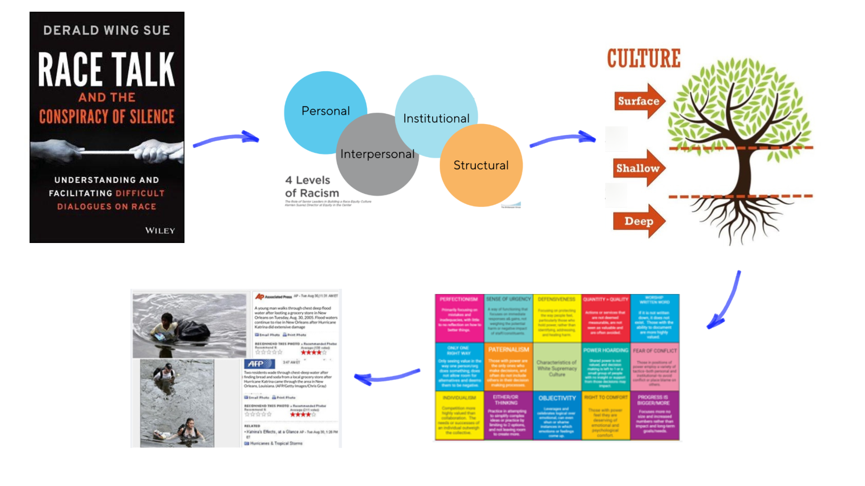
Reviewing
Modules 1 + 2
dominant
culture
Notes:
NADIA
Review protocols, norms, or patterns that manifest around race, racism, and culture in our society
These practices are fostered under the umbrella of dominant culture (or WSC) - as we established last session
So we see protocols or barriers to talking about race show up as “politeness” or “academic” or “colorblind” as a way to maintain dominant culture
Types of racism appear at different levels of interaction and without an actor working to interrupt or stop, they maintain the status quo of dominant culture
This again occurs in spaces of work and communications - patterns of behaviors, norms, or expectations that maintain dominant culture
So, we can analyze this in a way that illustrates, we are being organized in a particular direction, the maintenance of the status quo, the maintenance of dominant culture, which is WSC
dominant norms that maintain the status quo, we are being organized already (as the buffer class) so we need to organize in the opposite direction to disrupt the status quo (WSC)
We can do this several ways that y’all have identified:
making what is implicit explicit!
developing the ability to identify racism at different levels and implementing protocols to interrupt and disrupt those patterns/actions/standards
understanding power - our own power and our institutions power - to leverage different norms or patterns

Slide 106
Overview of the Day
Will Do
Begin to explore what we need from our organizations or agencies to make our grantmaking anti-racist
Begin to explore what we need from ourselves
Learn how peer-practitioners commit to and practice anti-racism
Begin to strategize where in our processes and practices we may embed anti-racism
Might Do
Understand how each of us is prepared to participate in anti- racist work from our positions
Won’t Do
Leave today with resolution
Generate perfect answers for how to dismantle structural racism within arts funding
‹#›
Notes:
Screen share: Overview of the day (3 minutes): Nadia
Why lead with race? 20 minutes (12:40 – 1:10)
Barriers to Talking about Race: 30 minutes (1 – 1:30)
Key Concepts Related to Race: 30 minutes (1:30 – 2:00)
Wrap-up and assignments for next Act: 10 minutes (2 – 2:10)

Slide 107
Reflecting on Your Power
‹#›

Slide 108
Ask Yourself During the Presentations
What do I need to remind myself to do:
    Before and as I asses existing grant programs?
    Before and as I conceptualize a new grant program?
    Before I propose a grant program to our board/commission?
‹#›

Slide 109
Ask Yourself During the Presentations
What do I need to remind myself to do:
    Before I design an application process?
    Before I decide selection criteria?
    Before I decide a selection process?
‹#›

Slide 110
Ask Yourself During the Presentations
What are other decision-points when I need to remind myself to engage in equitable strategies?
Where can I influence the embrace of racial equity in my organization/agency? Among my peers?
‹#›

Slide 111
Ask Yourself During the Presentations
What further strategies can I utilize?
What questions do I need to ask myself for personal accountability in this work?
‹#›

Slide 112
Overview of the Case Studies
Three takeaways:
Secure Buy-in from Leadership
Change Your Processes for Those that Work Differently
Address Historic Disinvestment Over the Long Term
‹#›

Slide 113
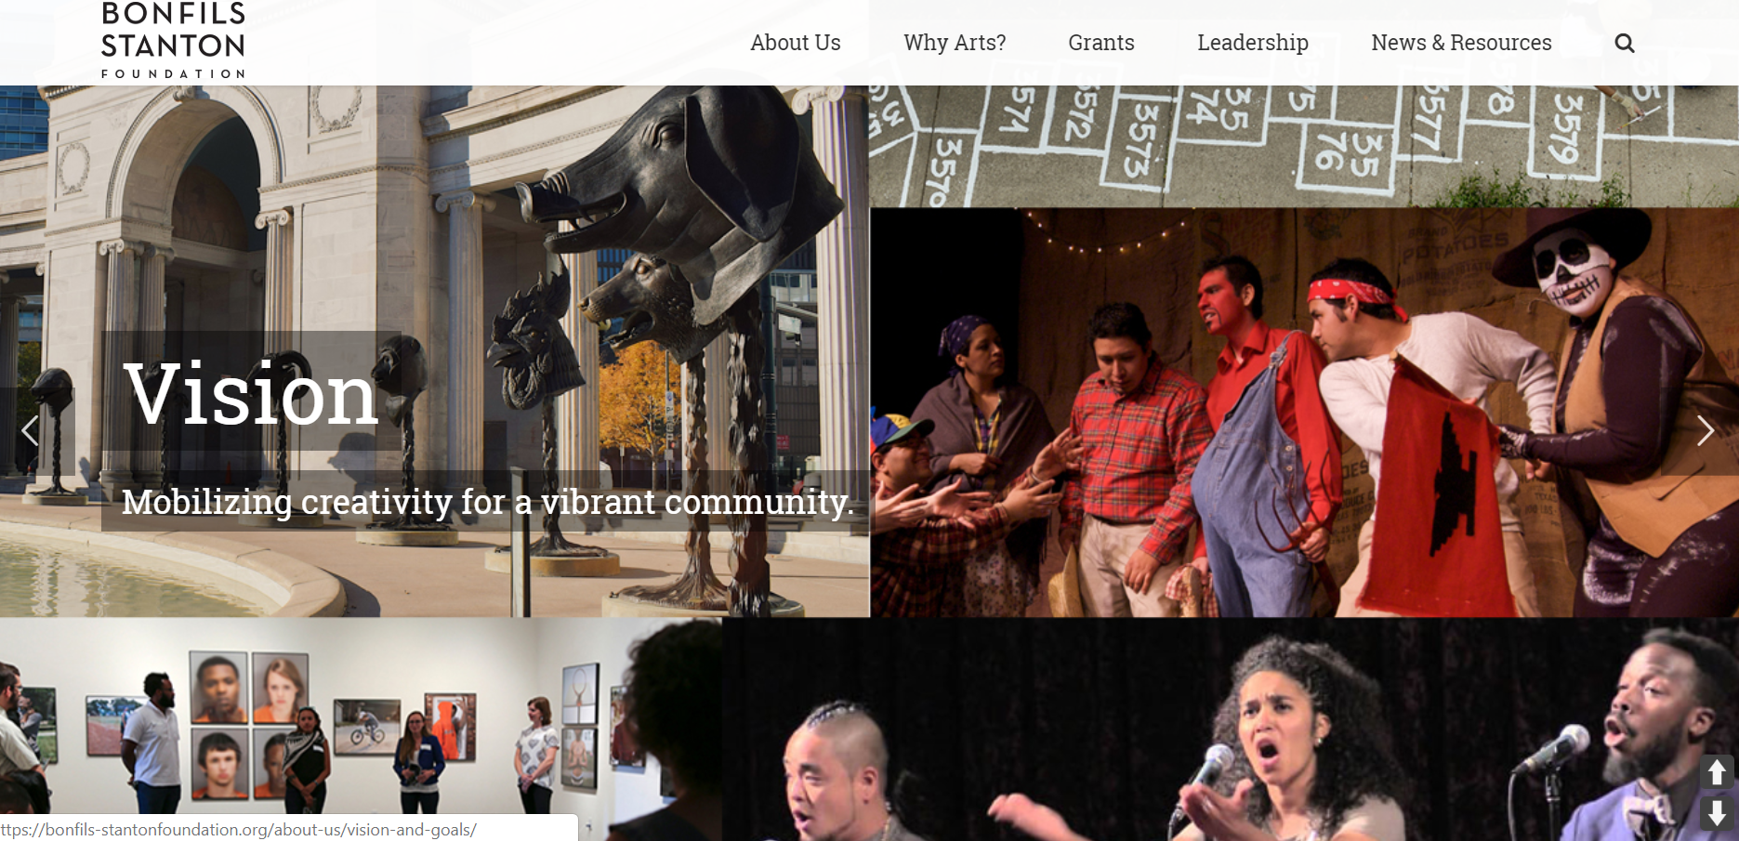
Case Study: Bonfils-Stanton Foundation
Strategies for Intervention: Secure Buy-in From Leadership
‹#›
Notes:
GIA Case Studies - EDDIE
They switched to an arts strategy as a means to support the health of their communities –
SIAP – education, health, safety
Broadened their pool of nominators - entirely opened up the nominating process
Rotated the selection panel members and ensured a higher proportion of poc individuals on the selection panel
Have become more embracing of leaders of smaller organizations, given that a much higher percentage of these groups are primarily serving poc communities and are led by poc individuals
Who: Bonfils-Stanton Foundation
What: A series of modifications to the foundation’s long-standing practices in order to create more opportunities for funding for people of color (POC)/African, Latinx, Arab, Asian, Native American (ALAANA) organizations and individuals.
Where: Denver, CO
Interviewee: Gary Steuer, president, Bonfils-Stanton Foundation
Program Description:
Bonfils-Stanton Foundation made a series of changes to the foundation’s long-standing practices in order to create more opportunities for funding for ALAANA/poc organizations and individuals.
Bonfils-Stanton Foundation has made intentional changes in the Livingston Fellowship Program
First, they broadened their pool of nominators.
They subsequently entirely opened up the nominating process.
They have also rotated the selection panel members and ensured a higher proportion of ALAANA/poc individuals on the panel.
Bonfils-Stanton Foundation have become more embracing of leaders of smaller organizations, given that a much higher percentage of these groups are primarily serving ALAANA communities and are led by ALAANA/poc individuals
Background:
In 2015 Bonfils-Stanton commissioned Donna Walker-Kuhne, a nationally-recognized leader in building more diverse audiences in the arts, to study audience diversity efforts in Denver.
Her findings became a valuable tool for many cultural organizations and also led to the formation of an Arts & Diversity Task Force, which continues to meet regularly, and recently came to the Bonfils-Stanton Foundation to support a new effort to build a more diverse cultural workforce in Denver, which we have funded.
A comparable task force has now been formed, also with the support and encouragement of the Foundation, to work on equity issues in the arts for people with disabilities.
Role of Board:
After a preliminary board conversation around diversity, equity and inclusion in April of 2017, Bonfils-Stanton has continued to do research and craft ideas about how they could more formally embrace this work, and these values.
They began educating staff and board members, sharing research and information.
They had a much deeper full-day board conversation in April of 2018, leading to the formation of a DEI committee.
And after several months of work, the committee and staff together crafted a new integrated governing document, with a linked Mission, Vision and Values/Equity statement.
Bonfils-Stanton’s Board of Trustees has gone from never having an ALAANA/poc individual on the board since our incorporation in 1962, to now having three out of nine members.
Challenges:
Measuring Outcomes:
Over the past five years, ALAANA/poc Livingston Fellows have gone from a historical level of 20% over the previous ten years, to an average of 50%.
The 2018 class happened to be 80% ALAANA/poc.
Bonfils-Stanton has also encouraged the Fellowship cohort to embrace discussions of equity and racism as a shared value and critical environmental factor among all their organizations.
In their grantmaking, over the past five years the percentage of Bonfils-Stanton’s dollars going to organizations primarily serving ALAANA/poc or other traditionally marginalized communities has gone from 2.4% to 13.1%, a 275% increase in grant dollars.
Bonfils-Stanton’s Board of Trustees has gone from never having an ALAANA/poc individual on the board since their incorporation in 1962, to now having three out of nine members.
Advice from Bonfils-Stanton Foundation:
Take a broad view of organizations.
Try to build strong, honest relationship with grantees.
Work to break down the power differential between the funder and the applicant.
Give multi-year general operating support.
Provide risk capital to support both artistic risk and administrative/operating risks so that new efforts can be tried without their failure harming the organization so seriously that they can’t recover.

Slide 114
Case Study: Bonfils-Stanton Foundation
Strategies for Intervention: Secure Buy-in from Leadership
How have you secured buy-in from leadership?
‹#›
Notes:
GIA Case Studies - EDDIE
Broadened their pool of nominators - entirely opened up the nominating process
Rotated the selection panel members and ensured a higher proportion of poc individuals on the selection panel
Have become more embracing of leaders of smaller organizations, given that a much higher percentage of these groups are primarily serving poc communities and are led by poc individuals
Who: Bonfils-Stanton Foundation
What: A series of modifications to the foundation’s long-standing practices in order to create more opportunities for funding for people of color (POC)/African, Latinx, Arab, Asian, Native American (ALAANA) organizations and individuals.
Where: Denver, CO
Interviewee: Gary Steuer, president, Bonfils-Stanton Foundation
Program Description:
Bonfils-Stanton Foundation made a series of changes to the foundation’s long-standing practices in order to create more opportunities for funding for ALAANA/poc organizations and individuals.
Bonfils-Stanton Foundation has made intentional changes in the Livingston Fellowship Program
First, they broadened their pool of nominators.
They subsequently entirely opened up the nominating process.
They have also rotated the selection panel members and ensured a higher proportion of ALAANA/poc individuals on the panel.
Bonfils-Stanton Foundation have become more embracing of leaders of smaller organizations, given that a much higher percentage of these groups are primarily serving ALAANA communities and are led by ALAANA/poc individuals
Background:
In 2015 Bonfils-Stanton commissioned Donna Walker-Kuhne, a nationally-recognized leader in building more diverse audiences in the arts, to study audience diversity efforts in Denver.
Her findings became a valuable tool for many cultural organizations and also led to the formation of an Arts & Diversity Task Force, which continues to meet regularly, and recently came to the Bonfils-Stanton Foundation to support a new effort to build a more diverse cultural workforce in Denver, which we have funded.
A comparable task force has now been formed, also with the support and encouragement of the Foundation, to work on equity issues in the arts for people with disabilities.
Role of Board:
After a preliminary board conversation around diversity, equity and inclusion in April of 2017, Bonfils-Stanton has continued to do research and craft ideas about how they could more formally embrace this work, and these values.
They began educating staff and board members, sharing research and information.
They had a much deeper full-day board conversation in April of 2018, leading to the formation of a DEI committee.
And after several months of work, the committee and staff together crafted a new integrated governing document, with a linked Mission, Vision and Values/Equity statement.
Bonfils-Stanton’s Board of Trustees has gone from never having an ALAANA/poc individual on the board since our incorporation in 1962, to now having three out of nine members.
Challenges:
Measuring Outcomes:
Over the past five years, ALAANA/poc Livingston Fellows have gone from a historical level of 20% over the previous ten years, to an average of 50%.
The 2018 class happened to be 80% ALAANA/poc.
Bonfils-Stanton has also encouraged the Fellowship cohort to embrace discussions of equity and racism as a shared value and critical environmental factor among all their organizations.
In their grantmaking, over the past five years the percentage of Bonfils-Stanton’s dollars going to organizations primarily serving ALAANA/poc or other traditionally marginalized communities has gone from 2.4% to 13.1%, a 275% increase in grant dollars.
Bonfils-Stanton’s Board of Trustees has gone from never having an ALAANA/poc individual on the board since their incorporation in 1962, to now having three out of nine members.
Advice from Bonfils-Stanton Foundation:
Take a broad view of organizations.
Try to build strong, honest relationship with grantees.
Work to break down the power differential between the funder and the applicant.
Give multi-year general operating support.
Provide risk capital to support both artistic risk and administrative/operating risks so that new efforts can be tried without their failure harming the organization so seriously that they can’t recover.

Slide 115

Case Study: South Carolina Arts Commission
Strategies for Intervention: Change Your Processes for Those that Work Differently
‹#›
Notes:
GIA Case Studies - EDDIE
In 2012, the commission did an evaluation of the program and found that only 2% of the roster of their largest grant category were ALAANA organizations/orgs of color.

Slide 116
Case Study: South Carolina Arts Commission
Strategies for Intervention: Change Your Processes for Those that Work Differently
  In what ways have you changed your grantmaking practices to accommodate folks who work differently?
‹#›
Notes:
GIA Case Studies - EDDIE
Monitor the General Operating Support grant category: New organizations of color onto the grantee roster?

Slide 117
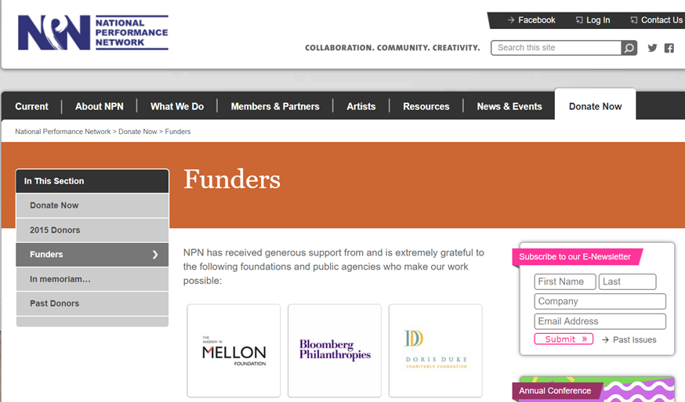
Case Study: NPN Leveraging a Network for Equity (LANE)
Strategies for Intervention: Address Historic Disinvestment Over the Long Term
Supported by Andrew W. Mellon Foundation, as part of Comprehensive Organizational Health Initiative
‹#›
Notes:
GIA Case Studies - EDDIE

Slide 118
Case Study: NPN Leveraging a Network for Equity (LANE)
Strategies for Intervention: Address Historic Disinvestment over the Long Term
How have you built or participated in efforts to address historic disinvestment?
‹#›
Notes:
GIA Case Studies - EDDIE
Who: National Performance Network and Visual Artists Network
What: Leveraging a Network for Equity (LANE)
Where: National
Interviewees: Caitlin Strokosch, President and CEO; Stanlyn Breve, Director of National Programs; and Sage Crump, LANE Program Specialist
Program Description:
Leveraging a Network for Equity (LANE) addresses systemic financial inequities in the nonprofit arts sector by delivering methodology and resources to strengthen the financial and organizational health of NPN/VAN Network Partners.
The LANE model uses a mix of convening, consultancy, and financial capital to remediate years of divestment.
The program specifically focuses on organizations of color, and geographically isolated and/or small- to mid-sized community groups.
LANE is grounded in the idea that we are stronger as a network and field when we can learn from the resourcefulness and adaptability exhibited by these organizations.
LANE positions these skills as necessary for all arts organization to create an infrastructure where all participants are able to thrive.
A collaboration between NPN/VAN, the Andrew W. Mellon Foundation, Nonprofit Finance Fund (NFF), and the participating organizations, LANE is a ten-year initiative with three phases.
Phase 1 (2015–16) involved diagnostics, education, and planning.
Phases 2 and 3 (2016–24) engage cohorts of six organizations each in a process of convening together and designing individual road maps for sustainability.
Each organizational participant receives:
up to $100,000 in recovery capital and additional general operating support
up to $800,000 in change/risk capital
access to an intentional community of peers strategically considering similar questions, through ongoing and in-person convenings
a customized plan outlining potential shifts in their business model and infrastructure
continued professional development and culturally competent consulting
general operating funds to increase capacity while they undertake this initiative
By 2024, NPN/VAN’s intent through LANE is to infuse up to twenty-four of the most vulnerable members of its network with up to $15M in total capital, and to develop new business models that can adapt to changing landscapes, ensuring cultural diversity within the network and growing leadership in the field.
Background:
NPN/VAN supports performing and visual artists in the creation and touring of new work, through an intentional network of presenting organizations engaged in risk-taking, community engagement, and the sharing of ideas and knowledge.
Begun in 1985 as a program of Dance Theatre Workshop in New York City, NPN/VAN was founded to address issues of artist isolation as well as the economic constraints of moving art around the country and the sharing of artist and community voices.
The organization’s commitment to cultural equity and social justice has been fundamental and evolving throughout its more than thirty-year history, advocating for artists, arts leaders, and organizations historically marginalized, and building the visibility, skills, learning environments, and resources for a more diverse and equitable sector.
Role of Board and Staff:
NPN/VAN’s Board of Directors, comprised of a majority of constituency representatives, fully supports LANE. LANE is staffed at NPN/VAN by a dedicated program specialist, under the department of National Programs and a part-time program assistant, and receives support from additional staff.
LANE also engages a curated pool of consultants who work directly with the participating organizations.
As a collaborator, NFF staff provide financial expertise as well as the analytical base, requisite data, training, and planning to better address the financial capacity and capitalization needs for the long-term durability of these critical arts organizations.
Finally, staff from the Mellon Foundation are deeply engaged in the process, not merely as funders but as thought partners as well as participants in many of the convenings and trainings with the LANE cohort.
Challenges:
Over the past decade, the number of organizations of color leaving NPN/VAN’s network and/or closing their doors has increased dramatically.
There are many contributing factors, but financial instability and organizational capacity are the primary reasons for their departure, and financial challenges of these organizations represent decades of marginalization by the arts-funding infrastructure in this country.
This lack of investment mirrors the field’s underlying racist assumptions about the value of these organizations of color and their work.
NPN/VAN recognizes that the significant loss of these organizations weakens the network and the field’s ability to provide relevant and inspiring cultural content to a significant number of communities.
As a result, voices are silenced, and the hegemonic picture of art and culture in America is maintained.
While LANE engages a limited number of organizations in its cohorts, the program is designed to develop knowledge, experience, processes, and models that support NPN/VAN’s entire network and other marginalized arts organizations through the field.
By partnering with NFF, LANE not only intends to shape how arts philanthropy can more responsibly support such organizations but to influence NFF’s practices nationwide throughout the nonprofit sector, by reshaping frameworks and resources through an equity lens.
Advice from NPN:
The first step in addressing historical inequities is individual work: how do you personally walk through the world as an antiracist?
Meaning, what are you actively doing to question the norms and hidden biases in your life and work?
Step two: get out of this field.
People in other sectors have been doing social justice work for a long time, and there are all these frames and theories that should be applied to our field.
We do not need to reinvent the wheel; we need to engage with folks who have been doing it better and longer.
Cross-sector collaborations are essential to the development of a just and equitable world.
— Sage Crump
Debt consolidation.
Maximum loan amount is $50,000, however, the approved loan amount is determined by an organization’s capacity to take on debt.
Current interest rate is 4.5% for “Secured” loans and 6.5% for “Unsecured Loans.”

Slide 119
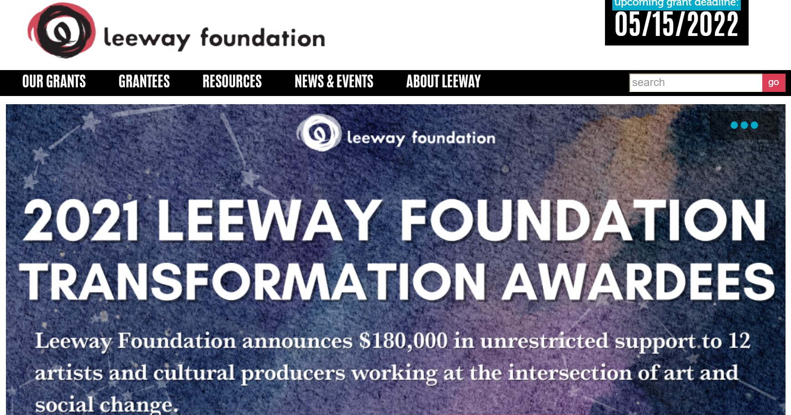
Case Study: Leeway Foundation
‹#›
Notes:
GIA Case Studies - Nadia

Slide 120

Case Study: Leeway Foundation
‹#›
Notes:
GIA Case Studies -Nadia

Slide 121

Case Study: Denver Arts & Venues
Tariana Navas-Nieves, Deputy Director
‹#›
Notes:
GIA Case Studies - Nadia

Slide 122

GIA Racial Equity in Arts Funding
A Public Funder’s Perspective
Tariana Navas-Nieves

Slide 123
A Racial Equity Practice:
  What IS an equity practice?
  Power & Privilege
  Proximity & Trust

Slide 124
4. It’s in the Details: STOP, SLOW DOWN & ASK THE QUESTIONS
    Who is applying and who is NOT?
    b. Who is making the funding decisions?
  c. What happens during the selection process?
  d. Why exactly do we need final reports?
  e. What about guidelines and applications?

Slide 125
  5. JEDI in Action - Operationalizing Values
  6. Expand our definition of arts and culture
  7. Embrace tension as part of the process

Slide 126
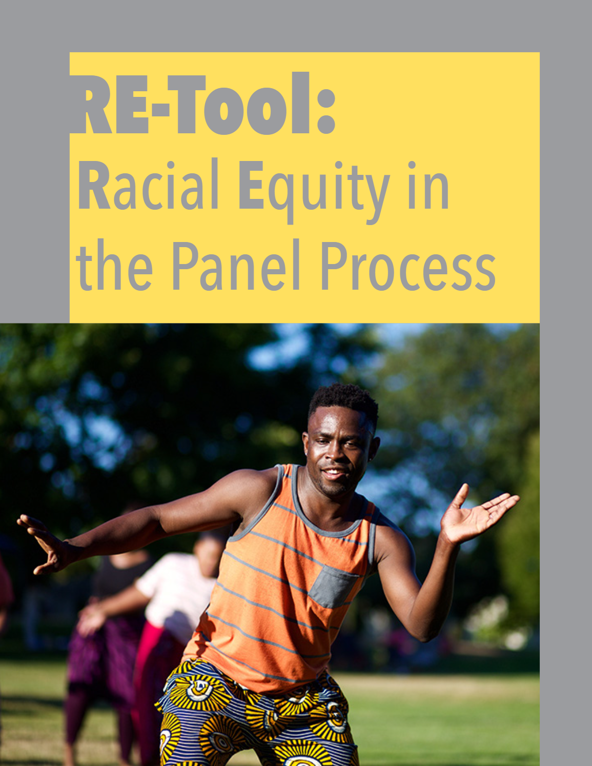
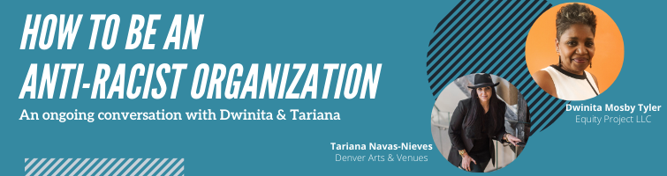
  Resources:
  https://www.artsandvenuesdenver.com/edi
  tariana.navas@denvergov.org

Slide 127
Q&A
‹#›
Notes:
Introduction: 30 minutes (12 – 12:30):
Welcome, intro facilitators + presenters, land acknowledgement (Share link: To learn more about Native land, https://native-land.ca/), community accountability (3 minutes): Eddie
Jam Board/Break out Groups: Introductory activity/Getting to know each other in small break-outs: (15 minutes): Cardozie
Screen share: Overview & goals (3 minutes): Nadia
Screen share: Group agreements (5 minutes): Nadia
Screen share: Overview of the day (3 minutes): Nadia

Slide 128

Break Time
‹#›
Notes:
Nadia: Break out groups

Slide 129
Reflecting on Your Power
‹#›

Slide 130
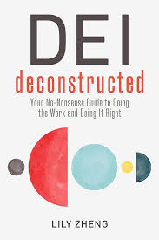
Knowing, Using, and Ceding Power
In their Book “DEI Deconstructed” author Lily Zheng offers us a framework for understanding
the role power plays in relationship to organizational structure and culture
‹#›
Notes:
Associated worksheet

Slide 131

“If we are to achieve DEI in the organizational sense, we will need to engage critically and often with power. With power, organizational priorities, goals, and strategies are set, and with power, individuals navigate conflict, self-advocate, and collectively organize”
‹#›

Slide 132
In your breakout groups:
Take 1 minute to volunteer for the following roles
    Facilitator
    Time Keeper
    Note taker
    Share out individual(s)
      Share out folks will give an overview of their content and highlights from the group conversation
Take 5 minutes to read through the given types of power slides
10 minutes In your group, discuss your given prompt
‹#›
Notes:
https://docs.google.com/presentation/d/1HR_RUOAwf8qWOPMLAqAX3BzRpTM3UzCE-wGyIo49wEA/edit#slide=id.g2deaed229fa_0_8

Slide 133
Types of Power
Reward Power | Is based on the individual's ability to give rewards and positive consequences if people do what is asked of them
Referent Power | Is based on the individual's likeability. People often are willing to do what you ask because they like and respect you
Legitimate Power | Is based on the individual's position/job/role. People see that position as holding power, so the individual holds power too
‹#›

Slide 134
Types of Power
Informative power | Is based on the individuals control of or access to information that is perceived as valuable
Expert Power | Is based on the individual's expertise, skill, and knowledge. People respect the individual's expertise and are influenced by it
Coercive Power | Is based on an individual’s ability to invoke fear in people. The individual has the ability to take away privileges or punish those who do not cooperate
Connection Power | Is based on who the individual knows. People see the individual as having power because of their connections to or relationships with influential or important people
‹#›
Notes:
\

Slide 135
Types of Power
When we can reverse engineer outcomes in the context of an orgs structure, culture, and strategy, we start to gain insights into how you might use power to create different outcomes, or more equitable outcomes.The first step is to know which kind of org your in. We’ll do this next session as we gear up towards putting our learnings into practice.
‹#›

Slide 136
The Role of Strategy
Strategy is the wildcard. While strategy is typically defined as the rationale or intentions behind those in and with power, in this context we can see it as the choices themselves that people with power make.
‹#›
Notes:
Centralization - the more top down teh decision making (paternalism) the greater the burden for those towards the top of the reporting structure, but also the less ownership staff have and with a lack of transparency or participatory decision making the less trust there is within the organization.
Formalization - too much and orgs lose the flexibility to deal with new challenges or changes in their environment, too little and orgs become inconsistent and unregulated
Complexity-
Power distance - how large is the distance between the most and least powerful within the organization? High power distance orgs value and desire hierarchies and there are few attempts to change power imbalances and inequities
Interdependence -
Uncertainty Avoidance - In cultures with high uncertainty avoidance, there is a greater preference for stiff rules and formal struutre. There may be a greater believe in “objective” reality or truth. “this or that”
Failure Avoidance - High failure avoidance cultures are often perfectionist, and offer little patience for errors or mistakes, and do not honor learning through failure
Strategy is the wildcard. While strategy is typically defined as the rationale or intentions behind those in and with power, in this context we can see it as the choices themselves that people with power make.

Slide 137
Small Group Discussion
What offerings do these presentations give you as you reflect on our own power within your organizations/agencies?
How can choice points and possible choices/actions be applied to the case?
How can the examples that has been shared provide possible strategies?
  From GIA?
  From Denise?
  From Tariana?
  From peers in this room?
* not fully baked ideas and thoughts in progress highly welcomed
‹#›

Slide 138
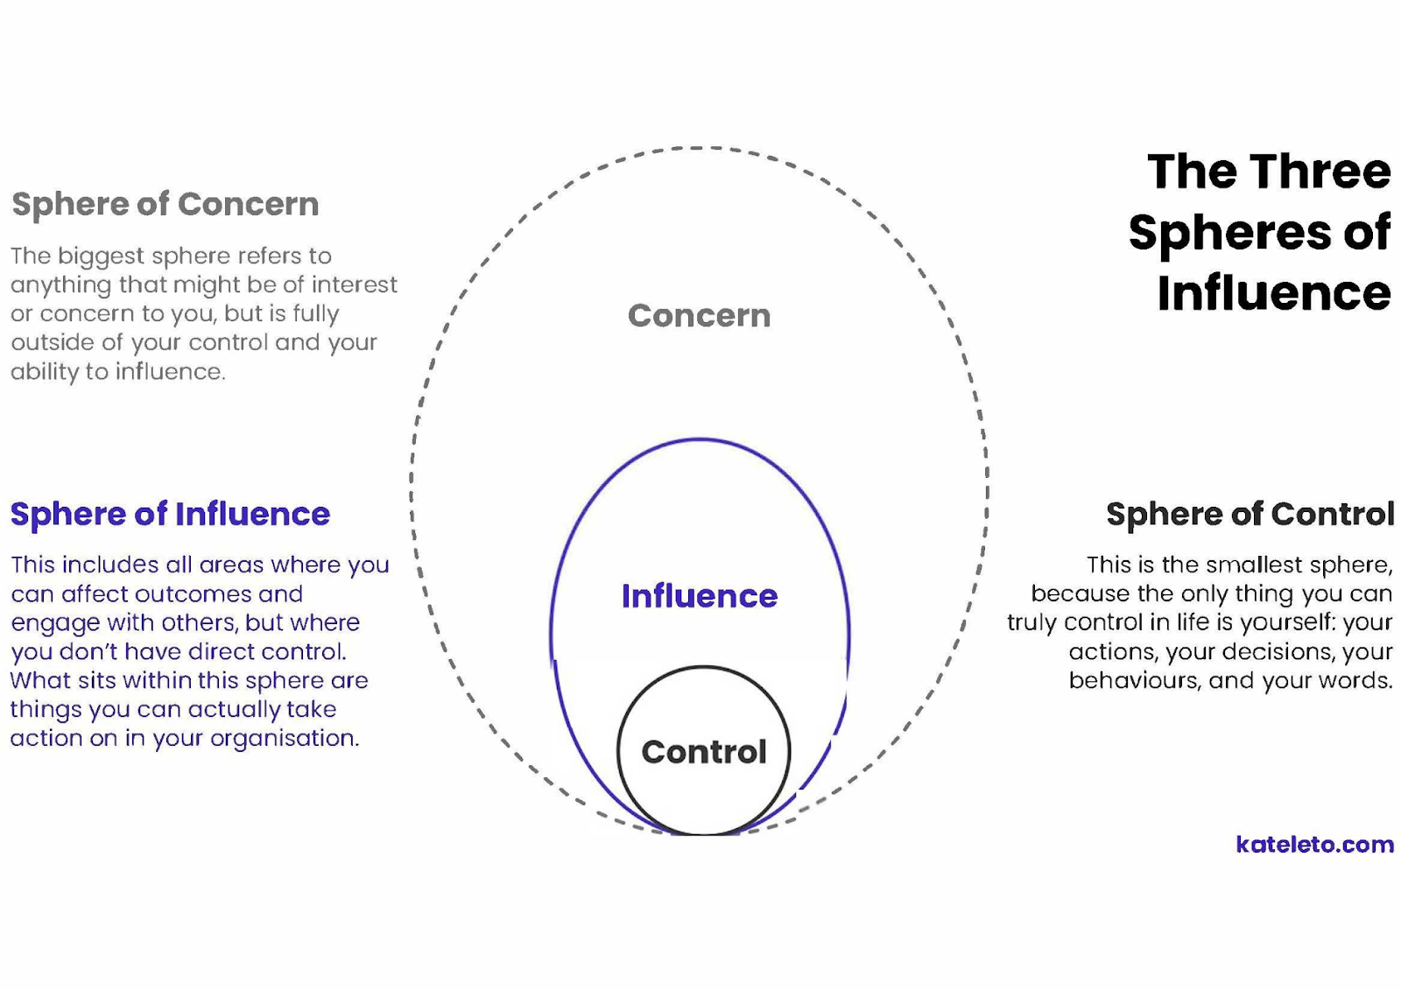
‹#›

Slide 139
In your breakout groups:
Take 1 minute to volunteer for the following roles
    Facilitator
    Time Keeper
    Note taker
    Share out individual(s)
      Share out folks will give an overview of their content and highlights from the group conversation
Take 5 minutes to read through your groups given content
10 minutes In your group, discuss your given prompt
‹#›
Notes:
Nadia: Break out groups

Slide 140
In your breakout groups:
What offerings do these presentations give you as you reflect on our own power within your organizations/agencies?
What offerings do these presentations give us as we consider the culture and structure of your organizations/agencies?
Be prepared to share back with the group
‹#›
Notes:
Nadia: Break out groups

Slide 141
Organizational Structure and Culture
Structure | The rules, roles, and responsibilities that coordinate people
centralization | The degree to which decisions are made from the top down
Fromalization | The degree to which organizations function is documented and follow strict rules
Complexity | The degree to which organizations divide work across jobs, divisions, and locations
Culture | Share assumptions and expectations for behavior in an environment
Power Distance | The degree to which power differences are normalized and accepted
Interdependence | The degree to which people see themselves as connected to a broader group
Uncertainty Avoidance | The degree to which uncertainty or ambiguity is avoided or devalued
Failure avoidance | The degree to which failure or imperfection is avoided or devalued
‹#›
Notes:
Centralization - the more top down teh decision making (paternalism) the greater the burden for those towards the top of the reporting structure, but also the less ownership staff have and with a lack of transparency or participatory decision making the less trust there is within the organization.
Formalization - too much and orgs lose the flexibility to deal with new challenges or changes in their environment, too little and orgs become inconsistent and unregulated
Complexity-
Power distance - how large is the distance between the most and least powerful within the organization? High power distance orgs value and desire hierarchies and there are few attempts to change power imbalances and inequities
Interdependence -
Uncertainty Avoidance - In cultures with high uncertainty avoidance, there is a greater preference for stiff rules and formal struutre. There may be a greater believe in “objective” reality or truth. “this or that”
Failure Avoidance - High failure avoidance cultures are often perfectionist, and offer little patience for errors or mistakes, and do not honor learning through failure
Strategy is the wildcard. While strategy is typically defined as the rationale or intentions behind those in and with power, in this context we can see it as the choices themselves that people with power make.

Slide 142
Types of Power
Reward Power | Is based on the individual's ability to give rewards and positive consequences if people do what is asked of them
Referent Power | Is based on the individual's likeability. People often are willing to do what you ask because they like and respect you
Legitimate Power | Is based on the individual's position/job/role. People see that position as holding power, so the individual holds power too
‹#›
Notes:
When we can reverse engineer outcomes in the context of an orgs structure, culture, and strategy, we start togain insights into how you might use power to create different outcomes, or more equitable outcomes.The first step is to know which kind of org your in. We’ll do this next session as we gear up towards putting our learnings into practice.

Slide 143
Types of Power
Informative power | Is based on the individuals control of or access to information that is perceived as valuable
Expert Power | Is based on the individual's expertise, skill, and knowledge. People respect the individual's expertise and are influenced by it
Coercive Power | Is based on an individual’s ability to invoke fear in people. The individual has the ability to take away privileges or punish those who do not cooperate
Connection Power | Is based on who the individual knows. People see the individual as having power because of their connections to or relationships with influential or important people
‹#›
Notes:
Sherylynn
Intro Small Group Share//Challenge Discussion;
Have the person who started be the same as the person who ended; not about advice...mainly about what you see; resist need to fix the problem
Breakout group discussion: Discuss and articulate possible solutions:
How can the places to intervene and possible types of interventions be applied to the case?
· How can the examples GIA has shared provide possible strategies?
· How can the experiences of my peers in this room provide possible strategies?

Slide 144
‹#›

Slide 145
How do they all interact?
Power is not only held by people but embedded into systems
Power comes in many forms
An organization’s structure describes the rules, roles, and responsibilities that coordinate the behavior of those in it
An organization’s culture describes its members’ shared understanding of its assumptions and expectations for behavior
An organization’s strategies describe the sum of what people choose to do with their power
Knowing how strategy, power, culture, and structure interact allows us to reverse engineer outcomes and create more equitable outcomes
‹#›

Slide 146
Where do we go from here?
‹#›
Notes:
Sherylynn
Goal for participants:
What can we learn from these case studies to apply to our own work in advancing racial equity in arts funding?

Slide 147
Small Group Discussion
In your breakout groups, discuss and generate alternative choice points and possible solutions* from your own perspectives.
How can choice points and possible choices/actions be applied to the case?
How can the examples GIA has shared provide possible strategies?
How can the experiences of my peers in this room provide possible strategies?
* not fully baked ideas and thoughts in progress highly welcomed
‹#›

Slide 148
Full Group Discussion
How did it feel to share out in your small groups?
What would you like to lift up from your experience in your small groups?
‹#›
Notes:
Jonny
Intro Small Group Share//Challenge Discussion;
Have the person who started be the same as the person who ended; not about advice...mainly about what you see; resist need to fix the problem
Breakout group discussion: Discuss and articulate possible solutions:
How can the places to intervene and possible types of interventions be applied to the case?
· How can the examples GIA has shared provide possible strategies?
· How can the experiences of my peers in this room provide possible strategies?

Slide 149
Assignments and Next Steps
Come back to our final gathering with a specific opportunity or challenge to discuss and work on
that might make your grantmaking anti-racist.
‹#›

Slide 150
Racial Equity in
Arts Funding Workshop
Online| May 29, 2024
Notes:
Assignments in advance of participation:
Watch the August 2018 Race Forward webinar on race on GIA’s website
Consider a possible vision of racial equity that could be manifest in your organization or entity in 25 years and bring to the workshop
Consider the challenges you’ve experienced related to racial equity in your organization or agency
Consider efforts or interventions solutions to these kinds of challenges you have executed, experienced, observed or heard of
Questions to share while they watch the webinar:
How does your organization or agency contribute to a culture of silence?
Interrupt a culture of silence?
What are some examples of organizational strategies (communications, external engagement etc) you’re currently using to interrupt a culture a of silence ?
8:30: Food and coffee
Day 1: 9am – 5:30pm
9:00 – 9:10: Welcome from hosts and facilitator introductions
9:15 – 9:25: Participant intros with “story huddle”
9:25 – 9:27: Overview and goals
9:27 – 9:35: Community agreements
9:35 – 9:40: Overview of day
9:40 – 9:55: Questions and observations on the webinar
Welcomes from: Eddie from GIA, local funders and RF
Understand key concepts related to structural racism.
Explore the expression of structural racism in the arts sector.
Identify opportunities for further learning and action to address structural and institutional racism in your organization or agency.
Explore how arts funders can shift resources or find new resources to support artists of color/African, Latinx, Asian, Arab and Native American (ALAANA) artists and arts organizations of people and communities of color.
Interventions or strategies, rather than solutions?
Option to have informal drinks and mingling instead

Slide 151
Welcome!
‹#›
Notes:
Introduction: 30 minutes (12 – 12:30):
Welcome, intro facilitators + presenters, land acknowledgement (Share link: To learn more about Native land, https://native-land.ca/), community accountability (3 minutes): Eddie
Jam Board/Break out Groups: Introductory activity/Getting to know each other in small break-outs: (15 minutes): Cardozie
Screen share: Overview & goals (3 minutes): Nadia
Screen share: Group agreements (5 minutes): Nadia
Screen share: Overview of the day (3 minutes): Nadia

Slide 152
Land Acknowledgement
GIA is headquartered on the unceded land of the Lenape and Wappinger peoples.
We ask you to join in acknowledging the Lenape and Wappinger communities, their elders both past and present, as well as future generations.
This acknowledgement demonstrates a commitment to beginning the process of working to dismantle the ongoing legacies of settler colonialism.
Notes:
Eddie
GIA is headquartered on the unceded land of the Lenape and Wappinger peoples.
We ask you to join in acknowledging the Lenape and Wappinger communities, their elders both past and present, as well as future generations.
This acknowledgement demonstrates a commitment to beginning the process of working to dismantle the ongoing legacies of settler colonialism.

Slide 153
Presenters
Jonny Soto-Altrogge, Facilitator, True North EDI
Nadia Elokdah, VP & Director of Programs, Grantmakers in the Arts
Jaime Sharp, Program Manager, Grantmakers in the Arts
Eddie Torres, President & CEO, Grantmakers in the Arts
Notes:
NADIA
Initial introductions for the room go-around: name, organization, gender pronouns

Slide 154
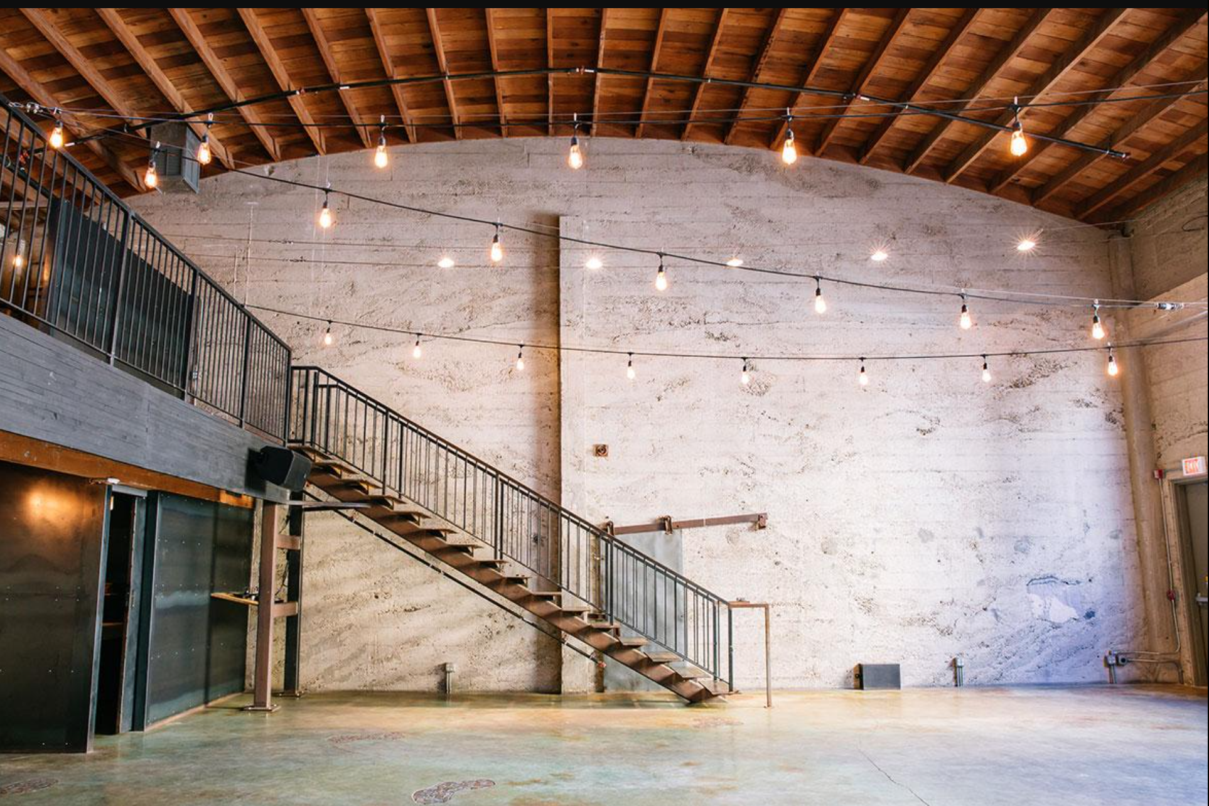
Notes:
NADIA - https://docs.google.com/presentation/d/1NeDL5gPpRP1TYiJi5ls3tn1hT-3qfh_T3mFRgKNa8bQ/edit?usp=sharing
Initial introductions for the room go-around: name, organization, gender pronouns

Slide 155
Showing up today
‹#›
Notes:
NADIA

Slide 156
Engagement Norms
Chat Norms
Feel free to eat, stretch, move.
We’d love to see you, but welcome you to turn off your camera if it is supportive for you.
Turn off your mic in the large group.
Please share your name when starting to speak so that everyone knows who is talking.
This is a learning space, please feel welcomed to share thoughts in progress and half-baked ideas!
Here’s how we encourage you to use the chat:
  Respond to a prompt
  Type “stack” or use raise hand function if you’d like to share something aloud or volunteer
  Share resources and tools
  Give each other affirmations ++
We may summarize ideas we see in the group chat aloud.
‹#›
Notes:
Screen share: Group agreements (5 minutes): Nadia
Screen share: Overview of the day (3 minutes): Nadia
GIA to ask participants to respond to:
Occupy Brave Space
Comfort – Stretch – Panic Zones
Cardozie to ask group to respond to:
Selective Vulnerability
GIA to ask participants to respond to:
Other agreements to add?

Slide 157
Group Agreements:
Occupy Brave Space
Commit to staying in your “Stretch Zone”
Honor selective vulnerability
Hold space for:
  a spectrum of experience in navigating these circumstances
  a spectrum of experience in relationship to the content
Acknowledge that everyone brings cultural knowledge to the discussion
Share the air / One mic
What is said stays, what is learned is leaves:
  Be prepared for facilitators to join you in breakout sessions for co-learning
Accept and expect a lack of closure
Source: YES! Jam Facilitator
‹#›
Notes:
Screen share: Group agreements (5 minutes): Nadia
Screen share: Overview of the day (3 minutes): Nadia
GIA to ask participants to respond to:
Occupy Brave Space
Comfort – Stretch – Panic Zones
Cardozie to ask group to respond to:
Selective Vulnerability
GIA to ask participants to respond to:
Other agreements to add?

Slide 158
Overview of the Day
Will Do
Reflect upon our learning over
the course of these past three workshop modules
Reflect upon how peer- practitioners commit to and practice anti-racist grantmaking
Discuss opportunities for anti-racism in our grantmaking
Might Do
Understand how each of us
is prepared to participate in anti-racist work
Won’t Do
Leave today with resolution
Generate perfect answers for how to dismantle structural racism within arts funding
‹#›
Notes:
Screen share: Overview of the day (3 minutes): Nadia
Why lead with race? 20 minutes (12:40 – 1:10)
Barriers to Talking about Race: 30 minutes (1 – 1:30)
Key Concepts Related to Race: 30 minutes (1:30 – 2:00)
Wrap-up and assignments for next Act: 10 minutes (2 – 2:10)

Slide 159
Reflecting on Your Power
‹#›

Slide 160
Knowing, Using, and Ceding Power
In their Book “DEI Deconstructed” author Lily Zheng offers us a framework for understanding
the role power plays in relationship to organizational structure and culture
‹#›
Notes:
Associated worksheet

Slide 161
“If we are to achieve DEI in the organizational sense, we will need to engage critically and often with power. With power, organizational priorities, goals, and strategies are set, and with power, individuals navigate conflict, self-advocate, and collectively organize”
‹#›

Slide 162
Types of Power
Reward Power | Is based on the individual's ability to give rewards and positive consequences if people do what is asked of them
Referent Power | Is based on the individual's likeability. People often are willing to do what you ask because they like and respect you
Legitimate Power | Is based on the individual's position/job/role. People see that position as holding power, so the individual holds power too
‹#›

Slide 163
Types of Power
Informative power | Is based on the individuals control of or access to information that is perceived as valuable
Expert Power | Is based on the individual's expertise, skill, and knowledge. People respect the individual's expertise and are influenced by it
Coercive Power | Is based on an individual’s ability to invoke fear in people. The individual has the ability to take away privileges or punish those who do not cooperate
Connection Power | Is based on who the individual knows. People see the individual as having power because of their connections to or relationships with influential or important people
‹#›
Notes:
\

Slide 164
Types of Power
When we can reverse engineer outcomes in the context of an orgs structure, culture, and strategy, we start to gain insights into how you might use power to create different outcomes, or more equitable outcomes.The first step is to know which kind of org your in. We’ll do this next session as we gear up towards putting our learnings into practice.
‹#›

Slide 165
The Role of Strategy
Strategy is the wildcard. While strategy is typically defined as the rationale or intentions behind those in and with power, in this context we can see it as the choices themselves that people with power make.
‹#›
Notes:
Centralization - the more top down teh decision making (paternalism) the greater the burden for those towards the top of the reporting structure, but also the less ownership staff have and with a lack of transparency or participatory decision making the less trust there is within the organization.
Formalization - too much and orgs lose the flexibility to deal with new challenges or changes in their environment, too little and orgs become inconsistent and unregulated
Complexity-
Power distance - how large is the distance between the most and least powerful within the organization? High power distance orgs value and desire hierarchies and there are few attempts to change power imbalances and inequities
Interdependence -
Uncertainty Avoidance - In cultures with high uncertainty avoidance, there is a greater preference for stiff rules and formal struutre. There may be a greater believe in “objective” reality or truth. “this or that”
Failure Avoidance - High failure avoidance cultures are often perfectionist, and offer little patience for errors or mistakes, and do not honor learning through failure
Strategy is the wildcard. While strategy is typically defined as the rationale or intentions behind those in and with power, in this context we can see it as the choices themselves that people with power make.

Slide 166
Organizational Structure and Culture
Structure | The rules, roles, and responsibilities that coordinate people
centralization | The degree to which decisions are made from the top down
Fromalization | The degree to which organizations function is documented and follow strict rules
Complexity | The degree to which organizations divide work across jobs, divisions, and locations
Culture | Share assumptions and expectations for behavior in an environment
Power Distance | The degree to which power differences are normalized and accepted
Interdependence | The degree to which people see themselves as connected to a broader group
Uncertainty Avoidance | The degree to which uncertainty or ambiguity is avoided or devalued
Failure avoidance | The degree to which failure or imperfection is avoided or devalued
‹#›

Slide 167
Organizational Structure and Culture
Structure | The rules, roles, and responsibilities that coordinate people
centralization | he more top down teh decision making (paternalism) the greater the burden for those towards the top of the reporting structure, but also the less ownership staff have and with a lack of transparency or participatory decision making the less trust there is within the organization.
Fromalization | too much and orgs lose the flexibility to deal with new challenges or changes in their environment, too little and orgs become inconsistent and unregulated
Complexity
Culture | Share assumptions and expectations for behavior in an environment
Power Distance | how large is the distance between the most and least powerful within the organization? High power distance orgs value and desire hierarchies and there are few attempts to change power imbalances and inequities
Interdependence
Uncertainty Avoidance | In cultures with high uncertainty avoidance, there is a greater preference for stiff rules and formal struutre. There may be a greater believe in “objective” reality or truth. “this or that”
Failure avoidance | High failure avoidance cultures are often perfectionist, and offer little patience for errors or mistakes, and do not honor learning through failure
‹#›
Notes:
Centralization - the more top down teh decision making (paternalism) the greater the burden for those towards the top of the reporting structure, but also the less ownership staff have and with a lack of transparency or participatory decision making the less trust there is within the organization.
Formalization - too much and orgs lose the flexibility to deal with new challenges or changes in their environment, too little and orgs become inconsistent and unregulated
Complexity-
Power distance - how large is the distance between the most and least powerful within the organization? High power distance orgs value and desire hierarchies and there are few attempts to change power imbalances and inequities
Interdependence -
Uncertainty Avoidance - In cultures with high uncertainty avoidance, there is a greater preference for stiff rules and formal struutre. There may be a greater believe in “objective” reality or truth. “this or that”
Failure Avoidance - High failure avoidance cultures are often perfectionist, and offer little patience for errors or mistakes, and do not honor learning through failure
Strategy is the wildcard. While strategy is typically defined as the rationale or intentions behind those in and with power, in this context we can see it as the choices themselves that people with power make.

Slide 168
The Role of Strategy
Strategy is the wildcard. While strategy is typically defined as the rationale or intentions behind those in and with power, in this context we can see it as the choices themselves that people with power make.
‹#›
Notes:
Centralization - the more top down teh decision making (paternalism) the greater the burden for those towards the top of the reporting structure, but also the less ownership staff have and with a lack of transparency or participatory decision making the less trust there is within the organization.
Formalization - too much and orgs lose the flexibility to deal with new challenges or changes in their environment, too little and orgs become inconsistent and unregulated
Complexity-
Power distance - how large is the distance between the most and least powerful within the organization? High power distance orgs value and desire hierarchies and there are few attempts to change power imbalances and inequities
Interdependence -
Uncertainty Avoidance - In cultures with high uncertainty avoidance, there is a greater preference for stiff rules and formal struutre. There may be a greater believe in “objective” reality or truth. “this or that”
Failure Avoidance - High failure avoidance cultures are often perfectionist, and offer little patience for errors or mistakes, and do not honor learning through failure
Strategy is the wildcard. While strategy is typically defined as the rationale or intentions behind those in and with power, in this context we can see it as the choices themselves that people with power make.

Slide 169
Discussion Prompt
What offerings do these presentations give us as we consider the culture and structure of your organizations/agencies
‹#›

Slide 170
‹#›

Slide 171
Small Group Discussions
What offerings do these presentations give you as you reflect on our own power within your organizations/agencies?
How can choice points and possible choices/actions be applied to the case?
How can the examples that has been shared provide possible strategies?
  From GIA?
  From Denise?
  From Tariana?
  From peers in this room?
NOTE: not fully baked ideas or thoughts in progress highly encouraged
‹#›
Notes:
Centralization - the more top down the decision making (paternalism) the greater the burden for those towards the top of the reporting structure, but also the less ownership staff have and with a lack of transparency or participatory decision making the less trust there is within the organization.
Formalization - too much and orgs lose the flexibility to deal with new challenges or changes in their environment, too little and orgs become inconsistent and unregulated
Complexity-
Power distance - how large is the distance between the most and least powerful within the organization? High power distance orgs value and desire hierarchies and there are few attempts to change power imbalances and inequities
Interdependence -
Uncertainty Avoidance - In cultures with high uncertainty avoidance, there is a greater preference for stiff rules and formal struutre. There may be a greater believe in “objective” reality or truth. “this or that”
Failure Avoidance - High failure avoidance cultures are often perfectionist, and offer little patience for errors or mistakes, and do not honor learning through failure
Strategy is the wildcard. While strategy is typically defined as the rationale or intentions behind those in and with power, in this context we can see it as the choices themselves that people with power make.

Slide 172
Break
‹#›

Slide 173
Reviewing Where We’ve Been
‹#›

Slide 174
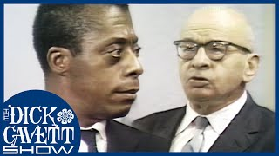
Review: Module 1
Why lead with race
Race Talk Protocols
Politeness
Academic
Color-blind
as barriers to real talk
Four layers of racism
‹#›
Notes:
Jonny: Module 1
Why Lead with Race
Race Talk protocols (Politeness, Academic, Color-blind) as barriers to real talk
Racism Created Race
Four layers of racism - personal + interpersonal
Module 2
How Culture Operates and is Weaponized
Language Biases
White Supremacy Culture in Our Work
Policies Precede Beliefs
Racial Equity in Funding
Module 3
Strategies/effective practices GIA has identified in our colleagues’ practices
Presentations by our colleagues

Slide 175
Review: Module 2
What is culture and how does it operate consciously and unconsciously?
How dominant culture manifests
in our lives to
create bias
‹#›
Notes:
Jaime
How Culture Operates and is Weaponized
Language Biases
White Supremacy Culture in Our Work ADD SLIDE OF WSC
How culture is weaponized:
If we talked about processing information, we process about 40 bits of information a second, consciously. And in that same second, process 11 million bits of information unconsciously. So, the unconscious is doing all the work…It sorts. It creates associations, and it fills in gaps.
How culture is weaponized: 1 – 1:40
Screen share: Introducing White Supremacy Culture (WSC); how we are acculturated to bias; how we weaponize WSC (Kendi’s terminologies and specifically anti-racist): (1 – 1:10pm) Nadia
Screen share: Belief-based racism (from Ibram X. Kendi): segregationists, assimilationists, anti-racists: Nadia
Screen share: Shift from grantees’ processes to practices of funding organizations (chuck symphony example): Nadia
Screen share: Through culture lens, how WSC operates, example: Sherylynn
Case Studies of institutional racism, white supremacy culture, bias
Institutional analysis, Tema Okun, where do these white supremacy culture items come up in institution, sector, etc.
Culture is a bridge from systems to ourselves, our institutions. What are you doing to prevent racism and encourage anti-racism?

Slide 176
Review: Module 2
Policies precede beliefs and shapes racial outcomes
Understanding racial equity in funding
Ford Foundation
National Endowment for the Arts
Expansion Arts
‹#›
Notes:
Jaime
Policies Precede Beliefs
Racial Equity in Funding

Slide 177

Review: Module 3
Strategies/effective practices GIA has identified in our colleagues’ practices to center racial equity in funding
Leeway Foundation
Denver Arts and Venues
‹#›
Notes:
Eddie https://padlet.com/nycoutwardbound/1es0rgbayzla0sza
Module 3
Strategies/effective practices GIA has identified in our colleagues’ practices
Presentations by our colleagues

Slide 178
Review: Module 3
Three takeaways from the Case Studies:
Secure Buy-in from Leadership
Change Your Processes for Those that Work Differently
Address Historic Disinvestment Over the Long Term
‹#›

Slide 179
Padlet Reflection + Connection
‹#›
Notes:
Jonny
use padlet for participants to highlight what learnings stand out to them and what connections they see between ideas, learning, and what others highlight/lift up
https://padlet.com/jaltrogge/series-reflection-ciym2igpusvda1ns

Slide 180
Challenges/Opportunities
‹#›

Slide 181
Using a Racial Equity Lens in Your Work: Small Group Discussion
In your breakout groups, each person takes a turn presenting an opportunity/challenge they are currently facing and work in groups to consider how you could apply a racial equity lens in analysis and anti-racist strategies for facing it.
‹#›
Notes:
Jaime: Break participants into groups. Each takes turns presenting their opportunities/challenges: 1:25 – 2:
This is the challenge or opportunity we were facing.
These were our decision points.
Here were the obstacles.
This is how we may address.

Slide 182
Using a Racial Equity Lens in Your Work:
Small Group Discussion
Have the person who started be the person who ends
Resist need to “fix” the problem, rather focus on strategies that center a racial equity lens
Share what you observe, reflect back what you are hearing, and ask questions to guide the presenter’s thinking
‹#›
Notes:
Jaime
Intro Small Group Share//Challenge Discussion;
Have the person who started be the same as the person who ended; not about advice...mainly about what you see; resist need to fix the problem
Breakout group discussion: Discuss and articulate possible solutions:
How can the places to intervene and possible types of interventions be applied to the case?
· How can the examples GIA has shared provide possible strategies?
· How can the experiences of my peers in this room provide possible strategies?

Slide 183
Processing Needs for Groundwork
‹#›
Notes:
Jonny - understanding that inequity is not only baked into our systems and institutions but also deeply socialized within us both in how we operate through the world but also in HOW we do work, our hope is to create or begin to create measures for accountability. Our goal is to intervene when we or our work defaults to the “norm” of our socialized inequity. How do we prime ourselves before engaging in equity work? What questions can we ask ourselves in order to keep both ourselves and others around us “safe” or moving forward

Slide 184
Preparing for Anti-Racist Grantmaking
To do this, what do I need from:
myself?
allies or community?
environment, organization, or agency?
‹#›
Notes:
Break-out group 1:
What can I remind myself to do :
Before and as I asses existing grant programs?
Before and as I conceptualize a new grant program?
Before I propose a grant program to our board/commission?
Before I design an application process?
Before I decide selection criteria?
Before I decide a selection process?

Slide 185
Break Out Groups
How might you access your own power to implement racial equity?
What's within your power to take those next steps?
‹#›
Notes:
Journaling: Commitments to ourselves:
What upcoming processes present opportunities for you to utilize racial equity strategies?
Consider how to access your own power in order to implement anti-racist grantmaking in your institution?
What reflections do you have on your own power within your institution and the field toward practicing anti-racist grantmaking?

Slide 186
Debrief Discussion
In thinking of the steps you've identified in the breakout rooms, what is the immediate challenge you foresee facing on either a personal or institutional level?
In our final moments together, what is resonating most with you? What are you curious about?
‹#›
Notes:
Break-out groups
We co-create Racial Equity Primes in the form of inquiry:
What do I need to remind myself to do:
Before and as I asses existing grant programs?
Before and as I conceptualize a new grant program?
Before I propose a grant program to our board/commission?
Before I design an application process?
Before I decide selection criteria?
Before I decide a selection process?
What are other decision-points when I need to remind myself to engage in equitable strategies?
Where can I influence the embrace of racial equity in my organization/agency? Among my peers?
What further strategies can I engage?
What questions do I need to ask myself to keep me going?
What questions can I ask myself to keep me accountable?

Slide 187
What’s Next?
Thank you!
GIA will send you this slide deck and the workshop materials and each others’ contact info
Share in the chat someone who inspires you to do this work
‹#›
Notes:
Journaling: Commitments to ourselves: 2:45 – 2:55: Sherylynn
What will be the first instance of your using your racial equity prime within the next seven days?
What other upcoming processes present opportunities for you to utilize racial equity strategies?
What other upcoming moments present opportunities for you to advocate for racial equity?

Slide 188
Racial Equity Resources: Philanthropy
GIA’s Statement on Racial Equity http://www.giarts.org/racial-equity-arts-philanthropy-statement-purpose
Philanthropic Initiative for Racial Equity www.racialequity.org/publications.html
Philanthropic Initiative for Racial Equity’s Short-Changed: Foundation Giving in Communities of Color www.racialequity.org/catalytic-change.html
Helicon Collaborative’s Not Just Money: Equity Issues in Cultural Philanthropy http://heliconcollab.net/our_work/not-just-money/
Racial Equity Tools www.racialequitytools.org
W.K. Kellogg Foundation’s Racial Equity Resource Guide www.racialequityresourceguide.org
Annie E. Casey Foundation’s Race Matters www.aecf.org/resources/race-matters-toolkit-users-guide/
The Racial Equity section of Grantmakers in the Arts’ website www.giarts.org/racial-equity-arts-philanthropy-statement-purpose
‹#›

Slide 189
Racial Equity Resources: Advocacy
Unite4Equity’s self-assessment: https://unite4equity.org/
Western States Center’s Moving a Racial Justice Agenda: Organizational Assessment: Are You Ready?: www.njjn.org/uploads/digital-library/westernstates3.pdf
Race Matters’ Organizational Self-Assessment tool: www.aecf.org/resources/race-matters-organizational-self-assessment/
Race Matters’ How to Talk About Race: www.aecf.org/m/resourcedoc/AECF-racemattershowtotalkaboutrace-2006.pdf
Race Matters’ PowerPoint presentation: www.aecf.org/resources/race-matters-powerpoint-presentation/
‹#›

Slide 190
Thank you!
‹#›

